Slide 1
3.6.16.18.19.20.25.29.31.33.36.39.44.46.47.52.56.59.64.67.80.82.93.96.98.99.111.124.126.129.134-136.139.143.144.146.150.154.159.162.165.168.173-175.177.181
练习:68.69.184.196
第3章
结构化查询语言

Slide 2







SQL对三级模式的支持
用户
外模式
视图V1
视图V2
基本表B1
基本表B2
基本表B3
模 式
存储文件S1
存储文件S2
内模式

Slide 3

SQL语言分类
CREATE
数据定义语言DDL
ALTER
DROP
SQL语言分类
INSERT
数据操作语言DML
UPDATE
DELETE
数据查询语言DQL
SELECT
GRANT
数据控制语言DCL
REVOKE

Slide 4
SQL特点
综合统一(一体化)
集DDL，DML，DCL于一体
单一的结构----关系，带来了数据操作符的统一
面向集合的操作方式
一次一集合
高度非过程化
用户只需提出“做什么”，无须告诉“怎么做”，不必了解存取路径
两种使用方式，统一的语法结构
SQL既是自含式语言（用户使用），又是嵌入式语言（程序员使用）
语言简洁，易学易用

Slide 5
01 数据定义语言DDL
02 数据操作语言DML
03 数据查询语言DQL
04 数据控制语言DCL
05 课堂练习

Slide 6




数据库对象
表：按行与列排列的具有相关信息的逻辑组。
索引：是根据指定的数据库表列建立起来的顺序。
视图：是由查询数据库表产生的虚拟表。
缺省值：对没有指定其具体值的列或列数据项赋予事先设定好的值。
规则：对数据库表中数据信息的限制。限定表的列。
触发器：由事件来触发的相关操作SQL。
存储过程：完成特定功能而汇集在一起的SQL程序语句。
用户：有权限访问数据库的人。
不同的数据库，数据库对象有所差别
Notes:
Database Objects
An Oracle database can contain multiple data structures. Each structure should be outlined in the database design so that it can be created during the build stage of database development.
Table: Stores data
View: Subset of data from one or more tables
Sequence: Generates primary key values
Index: Improves the performance of some queries
Synonym: Gives alternative names to objects
Oracle8 Table Structures
Tables can be created at any time, even while users are using the database.
You do not need to specify the size of any table. The size is ultimately defined by the amount of space allocated to the database as a whole. It is important, however, to estimate how much space a table will use over time.
Table structure can be modified online.
Note: More database objects are available but are not covered in this course.
Class Management Note
Tables can have up to 1000 columns and must conform to standard database object naming conventions. Column definitions can be omitted when using the AS subquery clause. Tables are created without data unless a query is specified. Rows are usually added by using INSERT statements.

Slide 7
课程中使用的表
EMP (职员表)
职工号EMPNO | 职工姓名ENAME | 职位JOB | 主管MGR | 入职时间HIREDATE | 月薪SAL | 佣金COMM | 部门DEPTNO
7839 | KING | PRESIDENT |  | 17-Nov-81 | 5000 |  | 10
7698 | BLAKE | MANAGER | 7839 | 1-May-81 | 2850 |  | 30
7782 | CLARK | MANAGER | 7839 | 9-Jun-81 | 1500 |  | 10
7566 | JONES | MANAGER | 7839 | 2-Apr-81 | 2975 |  | 20
7654 | MARTIN | SALESMAN | 7698 | 28-Sep-81 | 1250 | 1400 | 30
7499 | ALLEN | SALESMAN | 7698 | 20-Feb-81 | 1600 | 300 | 30
7844 | TURNER | SALESMAN | 7698 | 8-Sep-81 | 1500 | 0 | 30
7876 | ADAMS | CLERK | 7788 | 12-Jan-83 | 1100 |  | 20
7934 | MILLER | CLERK | 7782 | 23-Jan-82 | 1300 |  | 10
DEPT（部门表）
SALGRADE(薪水等级表)
部门编号DEPTNO | 部门名称DNAME | 办公地点LOC
10 | ACCOUNTING | NEW YORK
20 | RESEARCH | DALLAS
30 | SALES | CHICAGO
40 | OPERATIONS | BOSTON
50 | IT SERVICES | BOSTON
等级GRADE | 最低薪水LOSAL | 最高薪水HISAL
1 | 700 | 1200
2 | 1201 | 1400
3 | 1401 | 2000
4 | 2001 | 3000
5 | 3001 | 9999
Notes:
Tables Used in the Course
Three main tables will be used in this course. These are:
EMP table, which gives details of all the employees
DEPT table, which gives details of all the departments
SALGRADE table, which gives details of salaries for various grades
The structure and data for all the tables is given in Appendix B.

Slide 8
课程中使用的表
Student(学生信息表)
School（学院代码表）
学号Sno | 姓名SName | 性别SSex | 出生日期SBirthdate | 学院SchoolID
200333103213 | 蔡立雄 | 男 | 1986/7/9 | 350
200333103222 | 陈宇锋 | 男 | 1986/2/6 | 400
200333103231 | 崔继明 | 男 | 1985/11/4 | 400
200333103240 | 邓忻 | 女 | 1984/11/21 | 400
200333103277 | 郭冠鸿 | 男 | 1986/5/22 | 400
200333103286 | 何英炜 | 男 | 1987/3/15 | 400
200433103019 | 张彬彬 | 男 | 1986/2/25 | 480
200433103028 | 张超 | 男 | 1986/6/15 | 480
200433103046 | 张佳祺 | 女 | 1987/5/27 | 480
学院编号SchoolID | 学院名称SchoolName | 办公地址address
300 | 机械工程学院 | 机械大楼
350 | 建筑学院 | 建筑大楼
432 | 新闻与传播学院 | B8栋
433 | 政治与公共管理学院 | 5号楼
400 | 艺术学院 | B1栋
440 | 外国语学院 | 22号楼
450 | 电子商务学院 | B2栋
470 | 自动化学院 | 3号楼
480 | 计算机学院 | B3栋
Course（课程信息表）
SC（学生成绩表）
课程编号Cno | 课程名Cname | 先修课程Cpno | 学分CCredit
48000443 | C++程序设计语言 | NULL | 2
48000543 | 数据库系统概论 | 48000443 | 4
48003010 | 计算机应用基础 | NULL | 2
48005034 | 汇编语言 | NULL | 4
48005144 | 数据结构 | 48003010 | 4
48005254 | 计算机组成原理 | 48005345 | 3
48005345 | 操作系统 | 48003010 | 3
48005946 | 软件工程 | 48000543 | 4
学号Sno | 课程编号Cno | 分数Score
200333103240 | 48005144 | 72
200333103240 | 48005254 | 86
200333103277 | 48000543 | 89
200333103286 | 48000543 | 95
200433103019 | 48000443 | 86
200433103019 | 48000543 | 78
200433103028 | 48000443 | 88
200433103028 | 48000543 | 69

Slide 9
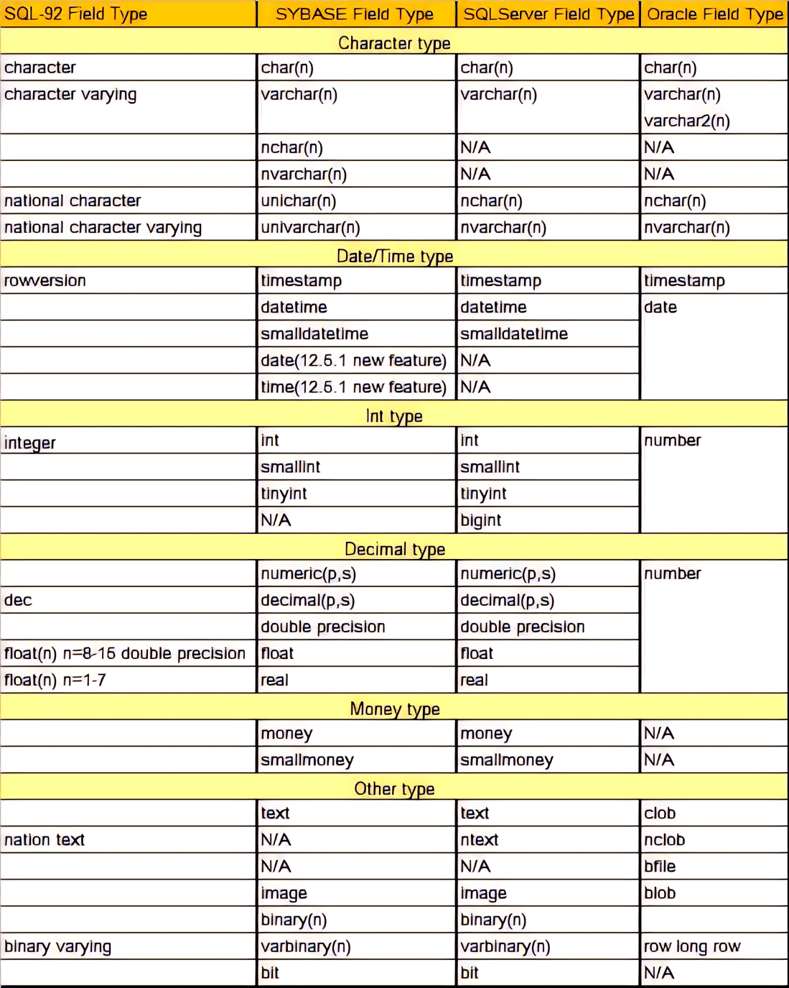
常用数据类型
字符串类型：char(n),varchar(n),nchar(n),nvarchar(n),clob
数值类型：int,numeric(n),float…
日期时间类：datetime,date,time
货币类型：money，smallmoney
布尔类型：bit
二进制类型：varbinary
XML 类型

Slide 10

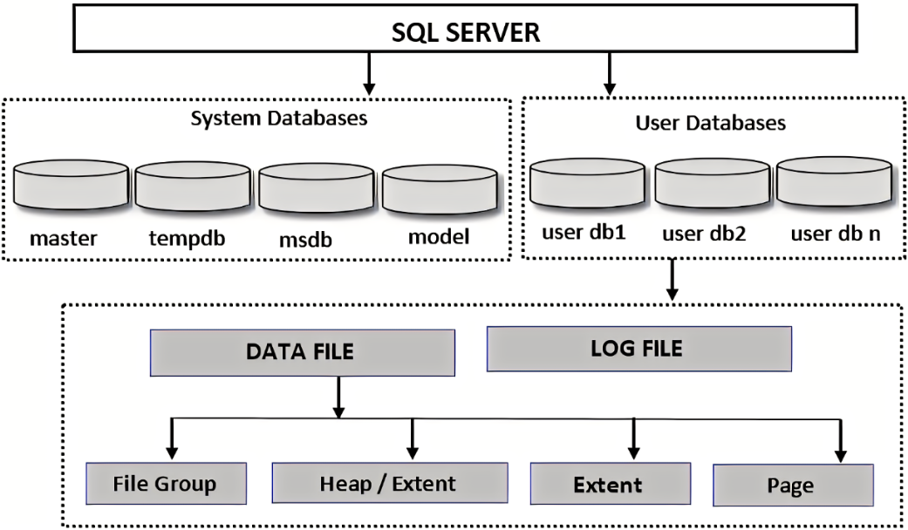
创建数据库/数据库表空间
已经安装了数据库软件，默认建立了几个系统数据库，为啥还需要创建数据库/数据库表空间呢？
master数据库：记录数据库所有系统级别的信息，这些信息用于控制用户数据库和数据操作。
msdb数据库：由 Enterprise Manager和Agent使用，记录任务计划信息、事件处理信息、数据备份及恢复信息、警告及异常信息。
model数据库：为用户数据库提供的样板，新的用户数据库都以model数据库为基础。每次创建一个新数据库时，先制作一个model数据库的拷贝，然后再将这个拷贝扩展成要求的规模。
tempdb数据库：一个共享的工作空间，SQL Server中的所有数据库都可以使用它。它为临时表和其他临时工作提供了一个存储区。

Slide 11
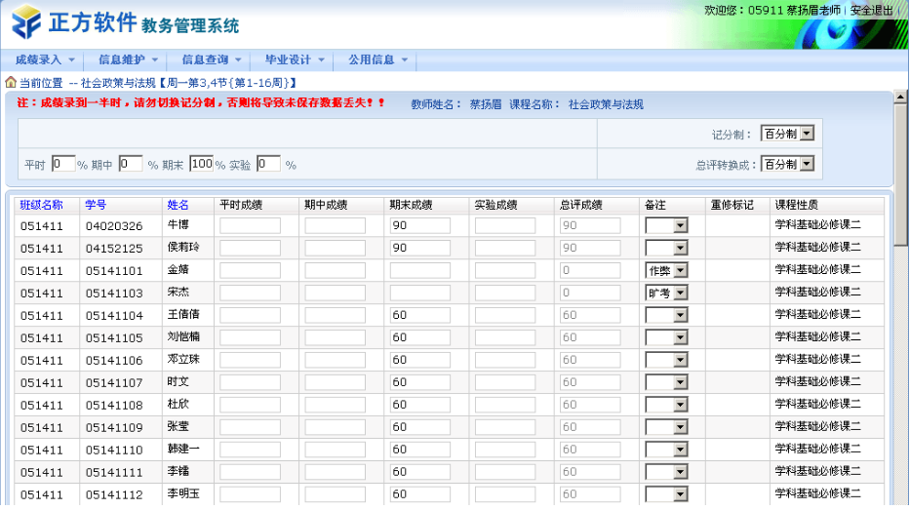
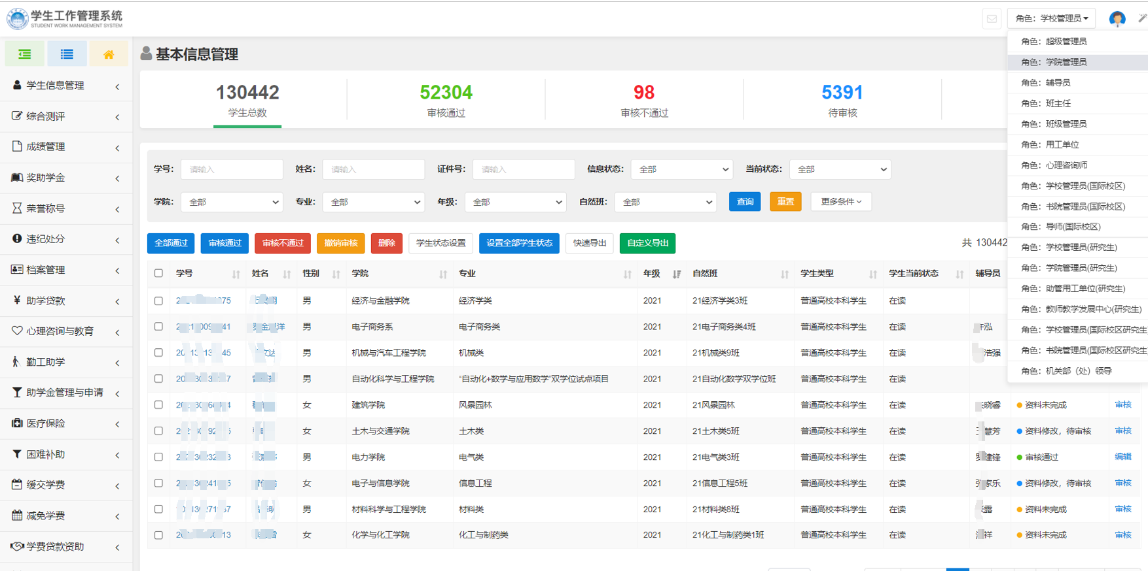
创建数据库/数据库表空间
教务
学工
开发商：浙江正方
都要存储学生信息
需要建立学生信息表student
重点关注学生学籍信息
开发商：广州数园
都要存储学生信息
需要建立学生信息表student
重点关注学生成长档案
如果都默认放在master数据库中，请问怎么解决重名的问题（厂家就是要这个student这个表名称，即使表内容完全不同）？相同名字的学生信息表哪个属于教务哪个属于学工呢？

Slide 12
创建属于特定应用的数据库
这个应用存储的数据库名字是啥？
数据文件、日志文件存在磁盘什么地方？给它们多大存储空间呢？空间不够怎么办？
CREATE DATABASE Employee
ON (NAME = Employee_dat,
FILENAME = ‘d:\empDB\Employeedat.mdf’,
SIZE = 10,
MAXSIZE = 50,
FILEGROWTH = 5 )
LOG ON (NAME = 'Employee_log’,
FILENAME = ‘d:\empDB\Employeelog.ldf’,
SIZE = 5MB,
MAXSIZE = 25MB,
FILEGROWTH = 5MB )
应用数据库的名字
数据文件定义
数据文件名字
物理文件名
初始大小
最大大小
文件增长方式
日志文件定义
日志文件名字
物理文件名
初始大小
最大大小
文件增长方式

Slide 13


指定多个数据文件和日志文件
CREATE DATABASE Archive
ON PRIMARY
(NAME = Arch1,FILENAME = 'c:\archdat1.mdf’, SIZE = 100MB, MAXSIZE = 200, FILEGROWTH = 20),
(NAME = Arch2, FILENAME = 'c:\archdat2.ndf', SIZE = 100MB, MAXSIZE = 200, FILEGROWTH = 20)
LOG ON
(NAME = Alog1, FILENAME = 'c:\alog1.ldf', SIZE = 100MB, MAXSIZE = 200, FILEGROWTH = 20),
(NAME = Alog2, FILENAME = 'c:\alog2.ldf', SIZE = 100MB, MAXSIZE = 200, FILEGROWTH = 20)
数据文件1定义
数据文件2定义
日志文件1定义
日志文件2定义

Slide 14
创建一个仅有数据库名的数据库
CREATE DATABASE Teach
问：
数据库数据文件、日志文件及各种参数的取值为啥呢？
数据库用到了modeldb的很多默认配置。如数据库存储路径、默认文件大小、数据及日志文件名称等等。

Slide 15
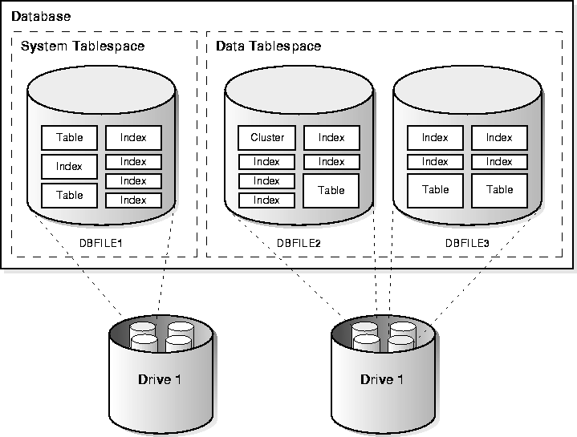
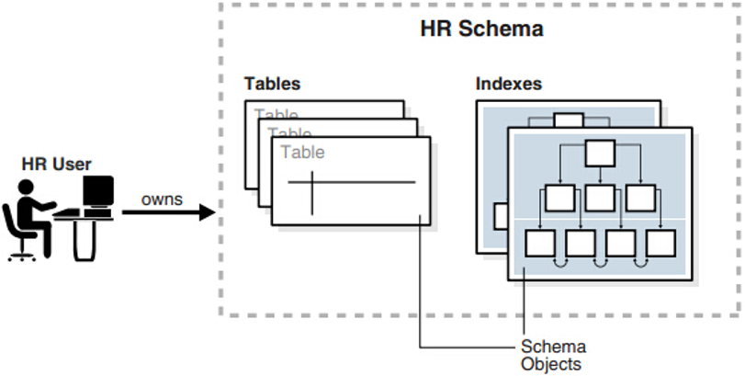
ORACLE创建数据库表空间
CREATE tablespace 表空间名 datafile '数据文件名' size 表空间大小;
CREATE tablespace data_hr datafile 'e:\oracle\oradata\hr\data_1.dbf' size 2000M;
CREATE tablespace idx_hr datafile 'e:\oracle\oradata\hr\idx_1.dbf' size 500M;

Slide 16
创建表CREATE TABLE
CREATE TABLE 表名（ 列名 数据类型[缺省值][NOT NULL] [,列名 数据类型[缺省值][NOT NULL]]…. [，UNIQUE（列名[，列名]….）] [，PRIMARY KEY（列名[，列名]…）] [，FOREIGN KEY （列名[，列名]…）
REFERENCES 表名（列名[，列名]…）] [, CHECK (条件)]）
DEFAULT ：指定列的缺省值；
NOT NULL：列值不能为空值；
UNIQUE：取值唯一的列名；
PRIMARY KEY：主关键字（主码、主键）列名；
FOREIGN KEY：外部码（键）列名；
REFERENCES：引用的外部码的表名和列名；
CHECK ：指定表级约束条件。

Slide 17
思考
电话号码、性别、年龄一般使用什么数据类型存储?
照片信息一般使用什么数据类型存储?
薪水一般使用什么数据类型存储?
学员姓名、家庭地址、电子邮件允许为空吗?
考试成绩允许为空吗?
在主键列输入的数值，允许为空吗?
一个表可以有多个主键吗?

Slide 18
创建表的SQL语句
逗号分隔，最后有右括号
--学院代码表
CREATE TABLE School (
SchoolID char(3) primary key, --学院ID
SchoolName varchar(50) not null) --学院名称
--学生信息表
CREATE TABLE Student (
Sno char(12) Primary key, --学号
SName VarChar(30) not null, --姓名
SSex char(2) CONSTRAINT ck_Sex CHECK (SSex in ('男', '女')), --性别
SBirthdate smalldatetime, --出生日期
SchoolID char(3)), --所属学院
CONSTRAINT FK_SchoolID FOREIGN KEY (SchoolID) REFERENCES School(SchoolID))
请同学们关注：创建这些表是否存在先后顺序？为什么？

Slide 19
创建表的SQL语句
--课程信息表
CREATE TABLE Course(
Cno char(8) primary key, --课程编号
Cname varchar(40) not null, --课程名称
Cpno char(8), --先修课程
CCredit int not null) --学分
--学生选课表
CREATE TABLE SC(
Sno CHAR(12) , --学号
Cno CHAR(8) , --课程号
Score int default 0, --成绩
Primary key (Sno, Cno), //because key have 2 features，需要单独说明
CONSTRAINT FK_Sno FOREIGN KEY (Sno) REFERENCES Student(Sno),
CONSTRAINT FK_Cno FOREIGN KEY (Cno) REFERENCES Course(Cno))

Slide 20
创建表的SQL语句
--创建部门信息表
CREATE TABLE DEPT (
DEPTNO char(2) not null,
DNAME varchar(20) not null,
LOC varchar(30) not null,
constraint PK_DEPT primary key (DEPTNO))
--创建职员信息表
CREATE TABLE EMP (
EMPNO char(4) not null,
ENAME varchar(20) not null,
JOB varchar(18) not null,
MGR char(4) null,
HIREDATE smalldatetime not null,
SAL float null,
COMM float null,
DEPTNO char(2)not null,
constraint PK_EMP primary key (EMPNO), //单独说明key的方式
constraint FK_DEPT foreign key (DEPTNO) references DEPT(DEPTNO))

Slide 21
创建表的SQL语句
--薪水等级表
CREATE TABLE SALGRADE (
GRADE varchar(2) not null,
LoSal float not null,
HiSal float not null,
constraint PK_SALGRADE primary key (GRADE))

Slide 22
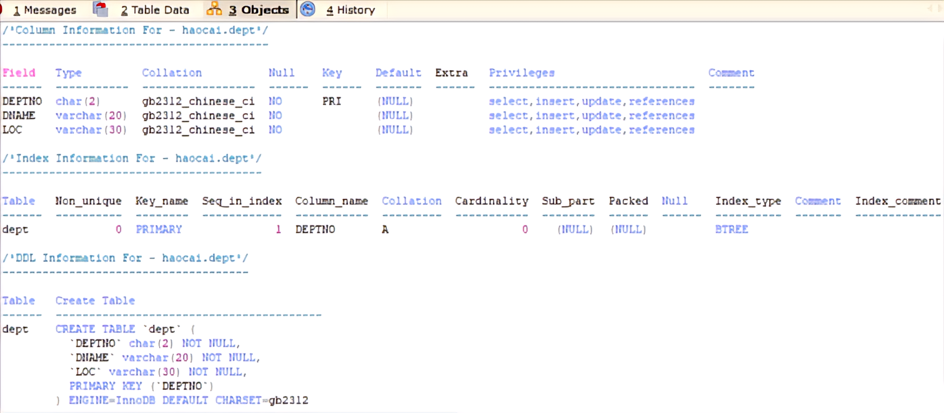
表创建后的相关信息
MySQL数据库显示表信息内容

Slide 23
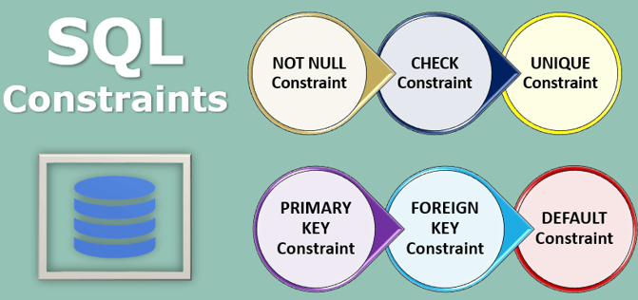
约束（ constraint ）
主流数据库支持的约束类型
NOT NULL
UNIQUE Key
PRIMARY KEY
FOREIGN KEY
CHECK
创建约束
在创建表时定义约束
在创建表后可以修改约束定义
约束可以定义在列或者表上

Slide 24
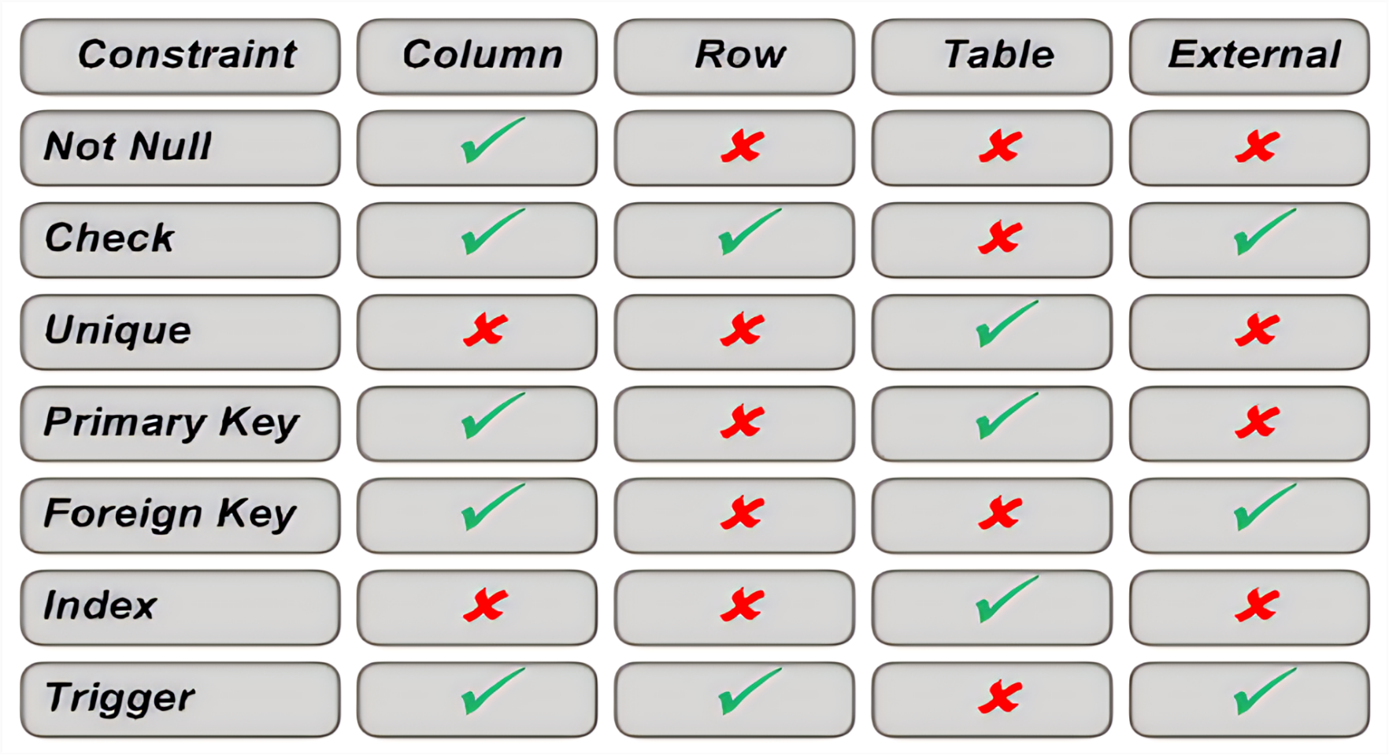
约束、索引可定义的对象

Slide 25
定义约束
列级约束定义
表级约束定义
column [CONSTRAINT constraint_name] constraint_type,
column,...
[CONSTRAINT constraint_name] constraint_type
(column, ...),
Notes:
Defining Constraints (continued)
Constraints are usually created at the same time as the table. Constraints can be added to a table after its creation and also temporarily disabled.
Constraints can be defined at one of two levels.
In the syntax:
constraint_name is the name of the constraint.
constraint_type is the type of the constraint.
Class Management Note
Explain that the column level and the table level refer to location in the syntax.

Slide 26
NOT NULL 约束
保证空值不进入定义的列
EMP(职员信息表)
EMPNO | ENAME | JOB | … | COMM | DEPTNO
7839 | KING | PRESIDENT |  |  | 10
7698 | BLAKE | MANAGER |  |  | 30
7782 | CLARK | MANAGER |  |  | 10
7566 | JONES | MANAGER |  |  | 20
NOT NULL约束
(在此列没有空值)
允许空值存在
NOT NULL 约束
Notes:
The NOT NULL Constraint
The NOT NULL constraint ensures that null values are not allowed in the column. Columns without the NOT NULL constraint can contain null values by default.

Slide 27
NOT NULL约束
定义在列级
CREATE TABLE emp(
empno NUMBER(4),
ename VARCHAR2(10) NOT NULL,
job VARCHAR2(9),
mgr NUMBER(4),
hiredate DATE,
sal NUMBER(7,2),
comm NUMBER(7,2),
deptno NUMBER(7,2) NOT NULL);
Notes:
The NOT NULL Constraint (continued)
The NOT NULL constraint can be specified only at the column level, not at the table level.
The example above applies the NOT NULL constraint to the ENAME and DEPTNO columns of the EMP table. Because these constraints are unnamed, Oracle Server will create names for them.
You can specify the name of the constraint while specifying the constraint.
Note: All the constraint examples described in this lesson may not be present in the sample tables provided with the course. If desired, these constraints can be added to the tables.
... deptno NUMBER(7,2)
CONSTRAINT emp_deptno_nn NOT NULL...

Slide 28
UNIQUE KEY 约束
UNIQUE key constraint
DEPT
DEPTNO | DNAME | LOC
10 | ACCOUNTING | NEW YORK
20 | RESEARCH | DALLAS
30 | SALES | CHICAGO
40 | OPERATIONS | BOSTON
Insert into
Not allowed (SALES already exists)
50 | SALES | DETROIT
60 | MARKETING | BOSTON
Allowed
Notes:
The UNIQUE Key Constraint
A UNIQUE key integrity constraint requires that every value in a column or set of columns (key) be unique¾that is, no two rows of a table have duplicate values in a specified column or set of columns. The column (or set of columns) included in the definition of the UNIQUE key constraint is called the unique key. If the UNIQUE key comprises more than one column, that group of columns is said to be a composite unique key.
UNIQUE key constraints allow the input of nulls unless you also define NOT NULL constraints for the same columns. In fact, any number of rows can include nulls for columns without NOT NULL constraints because nulls are not considered equal to anything. A null in a column (or in all columns of a composite UNIQUE key) always satisfies a UNIQUE key constraint.
Note: Because of the search mechanism for UNIQUE constraints on more than one column, you cannot have identical values in the non-null columns of a partially null composite UNIQUE key constraint.
Class Management Note
Explain to students that since SALES department already exists the first entry is not allowed. In the second entry, the department name is null; this entry is allowed.

Slide 29
UNIQUE KEY唯一约束
既可定义在列级也可以定义在表级
CREATE TABLE dept(
deptno NUMERIC(2),
dname VARCHAR(14),
loc VARCHAR(13),
CONSTRAINT dept_dname_uk UNIQUE(dname))
Notes:
The UNIQUE Key Constraint (continued)
UNIQUE key constraints can be defined at the column or table level. A composite unique key is created by using the table level definition.
The example on the slide applies UNIQUE key constraint to the DNAME column of the DEPT table. The name of the constraint is DEPT_DNAME_UK.
Note: Oracle Server enforces the UNIQUE key constraint by implicitly creating a unique index on the unique key.

Slide 30
PRIMARY KEY 约束
PRIMARY KEY
DEPT
DEPTNO | DNAME | LOC
10 | ACCOUNTING | NEW YORK
20 | RESEARCH | DALLAS
30 | SALES | CHICAGO
40 | OPERATIONS | BOSTON
Insert into
Not allowed (DEPTNO-20 already exists)
20 | MARKETING | DALLAS
 | FINANCE | NEW YORK
Not allowed (DEPTNO is null)
Notes:
The PRIMARY KEY Constraint
A PRIMARY KEY constraint creates a primary key for the table. Only one primary key can be created for a each table. The PRIMARY KEY constraint is a column or set of columns that uniquely identifies each row in a table. This constraint enforces uniqueness of the column or column combination and ensures that no column that is part of the primary key can contain a null value.

Slide 31
PRIMARY KEY 约束
既可定义在表级也可定义在列级
CREATE TABLE dept(
deptno char(2),
dname VARCHAR(14),
loc VARCHAR(13),
CONSTRAINT dept_dname_uk UNIQUE (dname),
CONSTRAINT dept_deptno_pk PRIMARY KEY(deptno))
Notes:
The PRIMARY KEY Constraint (continued)
PRIMARY KEY constraints can be defined at the column level or table level. A composite PRIMARY KEY is created by using the table level definition.
The example on the slide defines a PRIMARY KEY constraint on the DEPTNO column of the DEPT table. The name of the constraint is DEPT_DEPTNO_PK.
Note: A UNIQUE index is automatically created for a PRIMARY KEY column.

Slide 32
FOREIGN KEY 外键约束
DEPT
PRIMARY KEY
DEPTNO | DNAME | LOC
10 | ACCOUNTING | NEW YORK
20 | RESEARCH | DALLAS
EMP
EMPNO | ENAME | JOB | … | COMM | DEPTNO
7839 | KING | PRESIDENT |  |  | 10
7698 | BLAKE | MANAGER |  |  | 30
FOREIGN KEY
Insert into
Not allowed (DEPTNO为9 不在DEPT表中
7839 | FORD | MANAGER |  |  | 9
7571 | FORD | MANAGER |  |  | 20
Allowed
Notes:
The FOREIGN KEY Constraint
The FOREIGN KEY, or referential integrity constraint, designates a column or combination of columns as a foreign key and establishes a relationship between a primary key or a unique key in the same table or a different table. In the example on the slide, DEPTNO has been defined as the foreign key in the EMP table (dependent or child table); it references the DEPTNO column of the DEPT table (referenced or parent table).
A foreign key value must match an existing value in the parent table or be NULL.
Foreign keys are based on data values and are purely logical, not physical, pointers.

Slide 33
FOREIGN KEY 外键约束
既可在列级定义也可以在表级定义
CREATE TABLE emp(
empno char(4),
ename VARCHAR(10) NOT NULL,
job VARCHAR(9),
mgr NUMERIC(4),
hiredate DATETIME,
sal NUMERIC(7,2),
comm NUMERIC (7,2), --佣金
deptno NUMERIC(7,2) NOT NULL,
CONSTRAINT emp_deptno_fk FOREIGN KEY (deptno)
REFERENCES dept (deptno))
Notes:
The FOREIGN KEY Constraint (continued)
FOREIGN KEY constraints can be defined at the column or table constraint level. A composite foreign key is created by using the table-level definition.
The example on the slide defines a FOREIGN KEY constraint on the DEPTNO column of the EMP table. The name of the constraint is EMP_DEPTNO_FK.

Slide 34
CHECK 自定义约束
定义一个行必须满足的条件
..., deptno NUMERIC(2),
CONSTRAINT emp_deptno_ck
CHECK (DEPTNO BETWEEN 10 AND 99),...
Notes:
The CHECK Constraint
The CHECK constraint defines a condition that each row must satisfy. The condition can use the same constructs as query conditions, with the following exceptions:
References to the CURRVAL, NEXTVAL, LEVEL, and ROWNUM pseudocolumns
Calls to SYSDATE, UID, USER, and USERENV functions
Queries that refer to other values in other rows
A single column can have multiple CHECK constraints that reference the column in its definition. There is no limit to the number of CHECK constraints that you can define on a column.
CHECK constraints can be defined at the column level or table level.
Class Management Note
You can defer checking constraints for validity until the end of the transaction.
A constraint is deferred if the system checks that it is satisfied only on commit. If a deferred constraint is violated, then commit causes the transaction to roll back.
A constraint is immediate if it is checked at the end of each statement. If it is violated, the statement is rolled back immediately.

Slide 35
用子查询创建表
SQL Server:
select * into newtable from existtable where condition
例：建立计算机系学生情况基本表
select * into CsStudent from student where schoolID='480'
Oracle:
CREATE TABLE table
[column(, column...)] AS subquery;
create table CsStudent as select * from student
where school='480' ;
Notes:
Creating a Table from Rows in Another Table
A second method to create a table is to apply the AS subquery clause to both create the table and insert rows returned from the subquery.
In the syntax:
table is the name of the table.
column is the name of the column, default value, and integrity constraint.
subquery is the SELECT statement that defines the set of rows to be inserted into the new table.
Guidelines
The table will be created with the specified column names, and the rows retrieved by the SELECT statement will be inserted into the table.
The column definition can contain only the column name and default value.
If column specifications are given, the number of columns must equal the number of columns in the subquery SELECT list.
If no column specifications are given, the column names of the table are the same as the column names in the subquery.

Slide 36
修改表定义 ALTER TABLE
用ALTER TABLE:
增加一个新列、约束
修改一个存在的列
删除列
ALTER TABLE table_name
ADD (column datatype [DEFAULT expr]
[, column datatype]...)
ALTER TABLE table_name
MODIFY/Alter (column datatype [DEFAULT expr]
[, column datatype]...)
ALTER TABLE table_name
DROP (column...)
Notes:
ALTER TABLE Statement
After you create your tables, you may need to change the table structures because you omitted a column or your column definition needs to be changed. You can do this by using the ALTER TABLE statement.
You can add columns to a table by using the ALTER TABLE statement with the ADD clause.
In the syntax:
table is the name of the table.
column is the name of the new column.
datatype is the datatype and length of the new column.
DEFAULT expr specifies the default value for a new column.
You can modify existing columns in a table by using the ALTER TABLE statement with the MODIFY clause.
Note: The slide gives the abridged syntax for ALTER TABLE. More about ALTER TABLE is covered in a subsequent lesson.

Slide 37
增加新列
Student
新列
Sno | SName | SSex | SBirthdate | SchoolID
200333103213 | 蔡立雄 | 男 | 1986-07-09 | 350
200333103222 | 陈宇锋 | 男 | 1986-02-06 | 400
200333103231 | 崔继明 | 男 | 1985-11-04 | 400
200333103240 | 邓忻 | 女 | 1984-11-21 | 400
200333103277 | 郭冠鸿 | 男 | 1986-05-22 | 400
Nation
增加一个名族列进入学生信息表
Sno | SName | SSex | SBirthdate | SchoolID | Nation
200333103213 | 蔡立雄 | 男 | 1986-07-09 | 350
200333103222 | 陈宇锋 | 男 | 1986-02-06 | 400
200333103231 | 崔继明 | 男 | 1985-11-04 | 400
200333103240 | 邓忻 | 女 | 1984-11-21 | 400
200333103277 | 郭冠鸿 | 男 | 1986-05-22 | 400
Notes:
Adding a Column
The graphic adds the JOB column to DEPT30 table. Notice that the new column becomes the last column in the table.

Slide 38
增加列
用ADD语句增加列定义
ALTER TABLE student
ADD nation VARCHAR(9)
Table altered.
新增加的列变成最后的列，新增加的列一律为空值
Sno | SName | SSex | SBirthdate | SchoolID | Nation
200333103213 | 蔡立雄 | 男 | 1986-07-09 | 350
200333103222 | 陈宇锋 | 男 | 1986-02-06 | 400
200333103231 | 崔继明 | 男 | 1985-11-04 | 400
200333103240 | 邓忻 | 女 | 1984-11-21 | 400
200333103277 | 郭冠鸿 | 男 | 1986-05-22 | 400
200433103240 | 郑妍 | 女 | 1987-05-29 | 480
Notes:
Guidelines for Adding a Column
You can add or modify columns, but you cannot drop them from a table.
You cannot specify where the column is to appear. The new column becomes the last column.
The example above adds a column named JOB to the DEPT30 table. The JOB column becomes the last column in the table.
Note: If a table already contains rows when a column is added, then the new column is initially null for all the rows.

Slide 39
修改列
你能修改表一个列的数据类型，大小、默认值
对默认值的变更只影响后续插入表的数据
ALTER TABLE student
Alter coulumn Sname VARCHAR(50)
Notes:
Modifying a Column
You can modify a column definition by using the ALTER TABLE statement with the MODIFY clause. Column modification can include changes to a column's datatype, size, and default value.
Guidelines
Increase the width or precision of a numeric column.
Decrease the width of a column if the column contains only null values or if the table has no rows.
Change the datatype if the column contains null values.
Convert a CHAR column to the VARCHAR2 datatype or convert a VARCHAR2 column to the CHAR datatype if the column contains null values or if you do not change the size.
A change to the default value of a column affects only subsequent insertions to the table.

Slide 40
增加约束条件
为列增加约束条件，但受到表中已有数据的限制
INSERT INTO student VALUES('200633103028', '张超 ','男','1987-06-15', 480)
alter table student add unique(sname)
CREATE UNIQUE INDEX 终止，唯一索引冲突
Notes:
Modifying a Column
You can modify a column definition by using the ALTER TABLE statement with the MODIFY clause. Column modification can include changes to a column's datatype, size, and default value.
Guidelines
Increase the width or precision of a numeric column.
Decrease the width of a column if the column contains only null values or if the table has no rows.
Change the datatype if the column contains null values.
Convert a CHAR column to the VARCHAR2 datatype or convert a VARCHAR2 column to the CHAR datatype if the column contains null values or if you do not change the size.
A change to the default value of a column affects only subsequent insertions to the table.

Slide 41
删除列定义及约束(drop column/condition)
删除学生姓名必须取唯一值的约束
ALTER TABLE Student DROP UNIQUE(Sname)
删除属性列：直接/间接删除
先把表中要保留的列及其内容复制到一个新表中，再删除原表，再将新表重命名为原表名直接删除属性列:
ALTER TABLE Student
DROP column nation

Slide 42
删除表(drop table)
所有的数据及结构均被删除
任何未决的事务被提交
所有索引被删除
你不能 roll back 这个操作
DROP TABLE student
Notes:
Dropping a Table
The DROP TABLE statement removes the definition of an Oracle8 table. When you drop a table, the database loses all the data in the table and all the indexes associated with it.
Syntax
where: table is the name of the table.
Guidelines
All data is deleted from the table.
Any views or synonyms will remain but are invalid.
Any pending transactions are committed.
Only the creator of the table or a user with the DROP ANY TABLE privilege can remove a table.
The DROP TABLE statement, once executed, is irreversible. The Oracle Server does not question the action when you issue the DROP TABLE statement. If you own that table or have a high-level privilege, then the table is immediately removed. All DDL statements issue a commit, therefore making the transaction permanent.
DROP TABLE table;

Slide 43
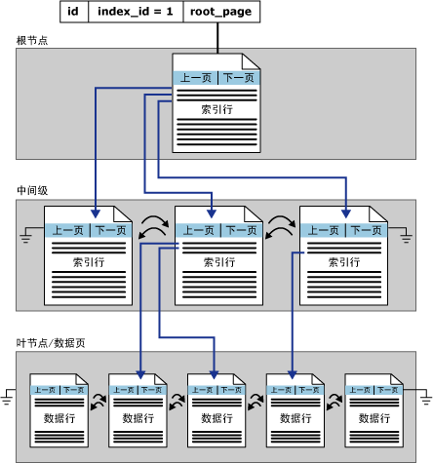
建立索引 CREATE INDEX
建立索引是加快查询速度的有效手段
建立索引
DBA或表的属主（即建立表的人）根据需要建立
有些DBMS自动建立以下列上的索引
PRIMARY KEY
UNIQUE
维护索引
DBMS自动完成
使用索引
DBMS自动选择是否使用索引以及使用哪些索引

Slide 44
建立索引CREATE INDEX
在职工信息表中基于姓名建立索引
create [unique][clustered] index <索引名>
on <表名>(<列名>[<次序>][，<列名>[<次序>]]…)
CREATE INDEX emp_ename_idx
ON emp(ename)

Slide 45
几种常见的索引类型
unique（distinct）：唯一性索引，不允许表中不同的行在索引列上取相同值。若已有相同值存在，则系统给出相关信息，不建此索引。系统并拒绝违背唯一性的插入、更新。
clustered：聚簇索引，表中元组按索引项的值排序并物理地聚簇在一起。一个基本表上只能建一个聚簇索引。适用范围：
很少对基表进行增删操作
很少对其中的变长列进行修改操作
asc/desc：索引表中索引值的排序次序，缺省为asc。

Slide 46
索引的说明
建立索引的两个主要目的：加快查询速度、保证行的唯一性；
可以动态地定义索引，即可以随时建立和删除索引；
一般不允许用户在数据操作中引用索引。索引如何使用完全由系统决定，这支持了数据的物理独立性；
一个表上可建多个索引。索引可以提高查询效率，但索引过多耗费空间，且降低了插入、删除、更新的效率。

Slide 47

索引的注意事项
下列情况，需要建立索引
在WHERE或连接条件中频繁使用的列
列取值范围较大时
列包含大量的非空值
查询少于2-4%行的大表
下列条件不要创建索引:
小表
列并不频繁用在查询条件中
查询超过2–4%的行
表频繁被更新（如操作日志表、事件表）
删除索引 DROP INDEX
从数据字典中删除索引定义
DROP INDEX index-name
Notes:
More Is Not Always Better
More indexes on a table does not mean it will speed up queries. Each DML operation that is committed on a table with indexes means that the indexes must be updated. The more indexes you have associated with a table, the more effort the Oracle Server must make to update all the indexes after a DML.
When to Create an Index
The column is used frequently in the WHERE clause or in a join condition.
The column contains a wide range of values.
The column contains a large number of null values.
Two or more columns are frequently used together in a WHERE clause or join condition.
The table is large and most queries are expected to retrieve less than 2-4% of the rows.
Remember that if you want to enforce uniqueness, you should define a unique constraint in the table definition. Then, a unique index is automatically created.

Slide 48
01 数据定义语言DDL
02 数据操作语言DML
03 数据查询语言DQL
04 数据控制语言DCL
05 课堂练习

Slide 49
插入数据INSERT
新的一行记录
50 DEVELOPMENT DETROIT
“…insert a new row
into DEPT table…”
DEPT
DEPTNO | DNAME | LOC
10 | ACCOUNTING | NEW YORK
20 | RESEARCH | DALLAS
30 | SALES | CHICAGO
40 | OPERATIONS | BOSTON
DEPT
DEPTNO | DNAME | LOC
10 | ACCOUNTING | NEW YORK
20 | RESEARCH | DALLAS
30 | SALES | CHICAGO
40 | OPERATIONS | BOSTON
50 | DEVELOPMENT | DETROIT
Notes:
Adding a New Row to a Table
The graphic above adds a new department to the DEPT table.

Slide 50
INSERT语法
向表中增加一行数据采用INSERT语句
采用这种INSERT语句一次只能插入一行记录
INSERT INTO table [(column [, column...])]
VALUES (value [, value...]);
Notes:
Adding a New Row to a Table (continued)
You can add new rows to a table by issuing the INSERT statement.
In the syntax:
table is the name of the table.
column is the name of the column in the table to populate.
value is the corresponding value for the column.
Note: This statement with the VALUES clause adds only one row at a time to a table.

Slide 51
插入一行记录
插入包含每列值的新行
按照表中列的默认顺序列出值
INSERT子句中的列是可选的。
用单引号括起字符和日期值
INSERT INTO dept (deptno, dname, loc)
VALUES ('50', 'DEVELOPMENT', 'DETROIT')
1 row created.
Notes:
Adding a New Row to a Table (continued)
Because you can insert a new row that contains values for each column, the column list is not required in the INSERT clause. However, if you do not use the column list, the values must be listed according to the default order of the columns in the table.
SQL> DESCRIBE dept
Name Null? Type
------------------------------- -------- ------------
DEPTNO NOT NULL NUMBER(2)
DNAME VARCHAR2(14)
LOC VARCHAR2(13)
For clarity, use the column list in the INSERT clause. Enclose character and date values within single quotation marks; do not enclose numeric values within single quotation marks.

Slide 52
插入带空值的行
隐式方法： 在列中忽略可以为空的列
明确方法: 对空值的列明确赋空值
INSERT INTO dept (deptno, dname )
VALUES ('60', 'MIS’)
1 row created.
INSERT INTO dept
VALUES ('70', 'FINANCE', NULL)
1 row created.
Notes:
Methods for Inserting Null Values
Be sure that the targeted column allows null values by verifying the Null? status from the SQL*Plus DESCRIBE command.
The Oracle Server automatically enforces all datatypes, data ranges, and data integrity constraints. Any column that is not listed explicitly obtains a null value in the new row.
Class Management Note
Common errors that can occur during user input:
Mandatory value missing for a NOT NULL column
Duplicate value violates uniqueness constraint
Foreign key constraint violated
CHECK constraint violated
Datatype mismatch
Value too wide to fit in column

Slide 53
插入函数值
getdate函数记录当前的日期和时间
MySQL：NOW（）获取当前日期时间
ORACLE：SYSDATE（）获取当前日期时间
INSERT INTO emp (empno, ename, job,
mgr, hiredate, sal, comm, deptno)
VALUES (7196, 'GREEN', 'SALESMAN',
7782, GETDATE(), 2000, NULL, 10)
1 row created.
Notes:
Inserting Special Values by Using SQL Functions
You can use pseudocolumns to enter special values in your table.
The example above records information for employee Green in the EMP table. It supplies the current date and time in the HIREDATE column. It uses the SYSDATE function for current date and time.
You can also use the USER function when inserting rows in a table. The USER function records the current username.
Confirming Additions to the Table
SQL> SELECT empno, ename, job, hiredate, comm
2 FROM emp
3 WHERE empno = 7196;
EMPNO ENAME JOB HIREDATE COMM
--------- ---------- --------- --------- ---------
7196 GREEN SALESMAN 01-DEC-97

Slide 54
插入特定的日期值
增加一个新的职员
INSERT INTO emp
VALUES (2296,'AROMANO','SALESMAN',7782,
convert(smalldatetime, '03-31-2005', 110),
1300, NULL, 10)
1 row created.
验证你的增加
EMPNO ENAME JOB MGR HIREDATE SAL COMM DEPTNO
----- ------- -------- ---- --------- ---- ---- ------
2296 AROMANO SALESMAN 7782 2005-03-31 1300 10
Notes:
Inserting Specific Date and Time Values
The format DD-MON-YY is usually used to insert a date value. With this format, recall that the century defaults to the current century. Because the date also contains time information, the default time is midnight (00:00:00).
If a date is required to be entered in another century and a specific time is also required, use the TO_DATE function.
The example on the slide records information for employee Aromano in the EMP table. It sets the HIREDATE column to be February 3, 1997.
If the RR format is set, the century may not be the current one.

Slide 55
注意事项
没有指定列，VALUES的值必须与数据库表结构的定义一致（包括顺序、类型、字段数），除IDENTITY字段。
INTO子句中没有出现的属性列，新记录在这些列上将取空值（NULL）或默认值。
如果在表定义时说明了NOT NULL的属性列不能取空值则操作失败。

Slide 56
插入子查询数据
INSERT INTO <表名>[(<属性列1>[,<属性列2 >…)] 子查询
CREATE TABLE CS_student
(Sno CHAR(12) primary key,
sname varchar(50) not null)
--插入计算机学院的学生到cs_student表中
insert into CS_student
select sno,sname
from Student where schoolID='480'

Slide 57
插入修改数据的约束性检查
DBMS在执行插入语句时会检查所插元组是否破坏表上已定义的完整性规则:
实体完整性
引用（参照）完整性
用户定义的完整性
如：
对于有NOT NULL约束的属性列是否提供了非空值
对于有UNIQUE约束的属性列是否提供了非重复值
对于有值域约束的属性列所提供的属性值是否在值域范围内

Slide 58
在表中变更数据
EMP
EMPNO | ENAME | JOB | … | COMM | DEPTNO
7839 | KING | PRESIDENT |  |  | 10
7698 | BLAKE | MANAGER |  |  | 30
7782 | CLARK | MANAGER |  |  | 10
7566 | JONES | MANAGER |  |  | 20
更新一行数据
EMPNO | ENAME | JOB | … | COMM | DEPTNO
7839 | KING | PRESIDENT |  |  | 10
7698 | BLAKE | MANAGER |  |  | 20
7782 | CLARK | MANAGER |  |  | 10
7566 | JONES | MANAGER |  |  | 20
Notes:
Changing Data in a Table
The graphic above changes the department number for Clark from 10 to 20.

Slide 59
UPDATE语句
修改存在的行用UPDATE语句
UPDATE可以对多行进行修改
UPDATE table
SET column = value [, column = value]
[WHERE condition]
Notes:
Updating Rows
You can modify existing rows by using the UPDATE statement.
In the above syntax:
table is the name of the table.
column is the name of the column in the table to populate.
value is the corresponding value or subquery for the column.
condition identifies the rows to be updated and is composed of column names expressions, constants, subqueries, and comparison operators.
Confirm the update operation by querying the table to display the updated rows.
For more information, see Oracle Server SQL Reference, Release 8.0, “UPDATE.”
Note: In general, use the primary key to identify a single row. Using other columns may unexpectedly cause several rows to be updated. For example, identifying a single row in the EMP table by name is dangerous because more than one employee may have the same name.
Class Management Note
Demo: l9sel.sql, l9upd.sql
Purpose: To illustrate displaying the initial state of data, and performing updates and viewing results.

Slide 60
更新行
用WHERE语句定义明确修改的行
忽略WHERE语句，则修改表中所有的行。要慎用。
UPDATE emp
SET deptno = 20
WHERE empno = 7782
1 row updated.
UPDATE employee
SET deptno = 20
14 rows updated.
Notes:
Updating Rows (continued)
The UPDATE statement modifies specific row(s), if the WHERE clause is specified. The example above transfers employee 7782 (Clark) to department 20.
If you omit the WHERE clause, all the rows in the table are modified.
Note: The EMPLOYEE table has the same data as the EMP table.
SQL> SELECT ename, deptno
2 FROM employee;
ENAME DEPTNO
---------- ---------
KING 20
BLAKE 20
CLARK 20
JONES 20
MARTIN 20
ALLEN 20
TURNER 20
...
14 rows selected.

Slide 61
采用子查询进行更新
更新职工号为7698的 job 与 department与职工7499一致
UPDATE emp
SET (job, deptno) =
(SELECT job, deptno
FROM emp
WHERE empno = 7499)
WHERE empno = 7698
1 row updated.
Oracle支持
Notes:
Updating Rows with a Multiple-Column Subquery
Multiple-column subqueries can be implemented in the SET clause of an UPDATE statement.
Syntax
Class Management Note
It may be worth showing participants that the results would be the same for the example above if two different subqueries were used in the SET clause as illustrated below:
SQL> UPDATE emp
2 SET job = (SELECT job FROM emp
3 WHERE empno = 7499),
4 deptno = (SELECT deptno FROM dept
5 WHERE dname = 'SALES')
6 WHERE empno = 7698;
UPDATE table
SET (column, column, ...) =
(SELECT column, column,
FROM table
WHERE condition)
WHERE condition;

Slide 62
基于别的表进行更新
用子查询的值更新表中列的值
UPDATE emp
SET deptno = (SELECT deptno
FROM emp
WHERE empno = 7788)
WHERE job = (SELECT job
FROM emp
WHERE empno = 7788)
2 rows updated.
Notes:
Updating Rows Based on Another Table
You can use subqueries in UPDATE statements to update rows in a table. The example above updates the EMPLOYEE table based on the values from the EMP table. It changes the department number of all employees with employee 7788’s job title to employee 7788’s current department number.

Slide 63
从表中删除数据
DEPT
DEPTNO | DNAME | LOC
10 | ACCOUNTING | NEW YORK
20 | RESEARCH | DALLAS
30 | SALES | CHICAGO
40 | OPERATIONS | BOSTON
50 | DEVELOPMENT | DETROIT
60 | MIS | DALLS
从DEPT表中删除一行
DEPTNO | DNAME | LOC
10 | ACCOUNTING | NEW YORK
20 | RESEARCH | DALLAS
30 | SALES | CHICAGO
40 | OPERATIONS | BOSTON
60 | MIS | DALLS
Notes:
Removing a Row from a Table
The graphic above removes the DEVELOPMENT department from the DEPT table (assuming there are no constraints defined on the DEPT table).
Class Management Note
After all the rows have been eliminated with the DELETE statement, only the data structure of the table remains. A more efficient method of emptying a table is with the TRUNCATE statement. You can use the TRUNCATE statement to quickly remove all rows from a table or cluster. Removing rows with the TRUNCATE statement is faster than removing them with the DELETE statement for the following reasons:
The TRUNCATE statement is a data definition language (DDL) statement and generates no rollback information. It will be covered in a subsequent lesson.
Truncating a table does not fire the table’s DELETE triggers.
If the table is the parent of a referential integrity constraint, you cannot truncate the table. Disable the constraint before issuing the TRUNCATE statement.

Slide 64
DELETE语句
用DELETE语句删除存在的行
DELETE [FROM] table [WHERE condition]
Notes:
Deleting Rows
You can remove existing rows by using the DELETE statement.
In the syntax:
table is the table name. condition identifies the rows to be deleted and is composed of column names, expressions, constants, subqueries, and comparison operators.
For more information, see Oracle Server SQL Reference, Release 8.0, “DELETE.”
Class Management Note
The DELETE statement does not ask for confirmation. However, the delete operation is not made permanent until the data transaction is committed. Therefore, you can undo the operation with the ROLLBACK statement if you make a mistake.

Slide 65
从表中删除数据
带WHERE语句明确删除指定的行
忽略WHERE语句则删除表中所有的行
DELETE FROM dept
WHERE dname = 'DEVELOPMENT’
1 row deleted.
DELETE FROM dept
4 rows deleted.
Notes:
Deleting Rows (continued)
You can delete specific row(s) by specifying the WHERE clause in the DELETE statement. The example above deletes the DEVELOPMENT department from the DEPARTMENT table. You can confirm the delete operation by displaying the deleted rows by using the SELECT statement.
Example
Remove all employees who started after January 1, 1997.
If you omit the WHERE clause, all rows in the table will be deleted. The second example on the slide deletes all the rows from the DEPARTMENT table because no WHERE clause had been specified.
Note: The DEPARTMENT table has the same data as the DEPT table.
SQL> SELECT *
2 FROM department
3 WHERE dname = 'DEVELOPMENT';
no rows selected.
SQL> DELETE FROM emp
2 WHERE hiredate > TO_DATE('01.01.97', 'DD.MM.YY');
1 row deleted.

Slide 66
基于另一个表删除行
用子查询的结果判定删除特定的行
DELETE FROM emp
WHERE deptno =
(SELECT deptno
FROM dept
WHERE dname ='SALES')
6 rows deleted.
Notes:
Deleting Rows Based on Another Table
You can use subqueries to delete rows from a table based on values from another table. The example above deletes all the employees who are in department 30. The subquery searches the DEPT table to find the department number for the SALES department. The subquery then feeds the department number to the main query, which deletes rows of data from the EMPLOYEE table based on this department number.

Slide 67
删除行违背约束
不能删除正在被外键引用的行
DELETE FROM dept
WHERE deptno = ‘10’
DELETE FROM dept
DELETE 语句与 COLUMN REFERENCE 约束 'FK_EMP_DEPT' 冲突
Notes:
Integrity Constraint Error
If you attempt to delete a record with a value that is tied to an integrity constraint, you will experience an error.
The example above tries to delete department number 10 from the DEPT table, but it results in an error because department number is used as a foreign key in the EMP table. If the parent record you attempt to delete has child records, then you receive the child record found violation ORA-02292.
Class Management Note
If there are referential integrity constraints in use, you might receive an Oracle Server error message when you attempt to delete a row. However, if the referential integrity constraint contains the ON DELETE CASCADE option, then the selected row and its children are deleted from their respective tables.

Slide 68
课堂练习
Student(学生信息)
School（学院代码）
Sno SName SSex Sbirthdate SchoolID
------------ ------- --- ---------- --------
200333103213 蔡立雄 男 1986-07-09 350
200333103222 陈宇锋 男 1986-02-06 400
200333103231 崔继明 男 1985-11-04 400
200333103240 邓 忻 女 1984-11-21 400
200333103277 郭冠鸿 男 1986-05-22 400
200333103286 何英炜 男 1987-03-15 400
200433103019 张彬彬 男 1986-02-25 480
200433103028 张 超 男 1986-06-15 480
200433103046 张佳祺 女 1987-05-27 480
……
SchoolID SchoolName addr
-------- --------------- -----
300 机械工程学院 机械大楼
350 建筑学院 建筑大楼
432 新闻与传播学院 B8栋
433 政治与公共管理学院 5号楼
400 艺术学院 B1栋
440 外国语学院 22号楼
450 电子商务学院 B2栋
470 自动化学院 3号楼
480 计算机学院 B3栋
……
Course（课程信息表）
SC（选课成绩表）
Cno Cname Cpno CCredit
-------- ------------------ -------- --------
48000443 C++程序设计语言 NULL 2
48000543 数据库系统概论 48000443 4
48003010 计算机应用基础 NULL 2
48005034 汇编语言与程序设计 NULL 4
48005144 数据结构 48003010 4
48005254 计算机组成原理 48005345 3
48005345 操作系统 48003010 3
48005946 软件工程 48000543 4
Sno Cno Score
------------ -------- -----
200333103240 48005144 72
200333103240 48005254 86
200333103277 48000543 89
200333103286 48000543 95
200433103019 48000443 86
200433103019 48000543 78
200433103028 48000443 88
200433103028 48000543 69
200433103046 48000543 66
200433103055 48000543 52

Slide 69
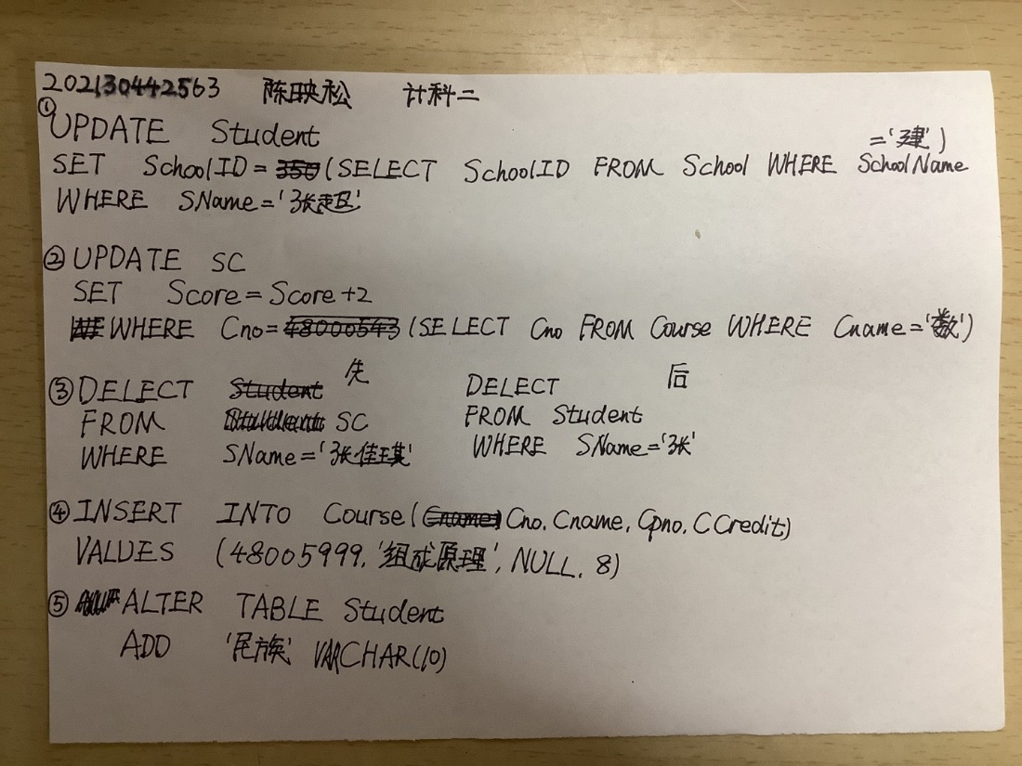
课堂练习
学生张超转到了建筑学院学习
把“数据库系统概论”课程的学生成绩均加2分
删除“张佳琪”学生信息
插入一门“组成原理”课程信息
在学生信息中加入“民族”属性

Slide 70
01 数据定义语言DDL
02 数据操作语言DML
03 数据查询语言DQL
04 数据控制语言DCL
05 课堂练习

Slide 71
SELECT语句
选择
投影
Table 1
Table 1
连接
Table 1
Table 2
Notes:
Capabilities of SQL SELECT Statement
A SELECT statement retrieves information from the database. Using a SELECT statement, you can do the following:
Selection: You can use the selection capability in SQL to choose the rows in a table that you want returned by a query. You can use various criteria to selectively restrict the rows that you see.
Projection: You can use the projection capability in SQL to choose the columns in a table that you want returned by your query. You can choose as few or as many columns of the table as you require.
Join: You can use the join capability in SQL to bring together data that is stored in different tables by creating a link through a column that both the tables share. You will learn more about joins in a later lesson.

Slide 72
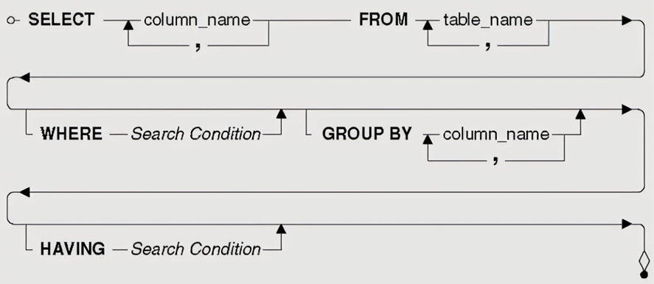
SELECT语法
SELECT 标识哪些列输出
FROM 标识从哪个表获取数据
SELECT [DISTINCT] {*, column [alias],...}
FROM table
Notes:
Basic SELECT Statement
In its simplest form, a SELECT statement must include the following:
A SELECT clause, which specifies the columns to be displayed
A FROM clause, which specifies the table containing the columns listed in the SELECT clause
In the syntax:
SELECT is a list of one or more columns.
DISTINCT suppresses duplicates.
* selects all columns.
column selects the named column.
alias gives selected columns different headings.
FROM table specifies the table containing the columns.
Note: Throughout this course, the words: keyword, clause, and statement would be used.
A keyword refers to an individual SQL element. For example, SELECT and FROM are keywords.
A clause is a part of an SQL statement. For example, SELECT empno, ename, ... is a clause.
A statement is a combination of two or more clauses. For example, SELECT * FROM emp is a SQL statement.

Slide 73
选择所有列（*）
SELECT *
FROM dept
DEPTNO DNAME LOC
--------- -------------- -------------
10 ACCOUNTING NEW YORK
20 RESEARCH DALLAS
30 SALES CHICAGO
40 OPERATIONS BOSTON
Notes:
Selecting All Columns, All Rows
You can display all columns of data in a table by following the SELECT keyword with an asterisk (*). In the example on the slide, the department table contains three columns: DEPTNO, DNAME, and LOC. The table contains four rows, one for each department.
You can also display all columns in the table by listing all the columns after the SELECT keyword. For example, the following SQL statement, like the example on the slide, displays all columns and all rows of the DEPT table:
Class Management Note
Let the students know that details of all the tables are given in Appendix B.
SQL> SELECT deptno, dname, loc
2 FROM dept;

Slide 74
选择特定的列
SELECT deptno, loc
FROM dept
DEPTNO LOC
--------- -------------
10 NEW YORK
20 DALLAS
30 CHICAGO
40 BOSTON
Notes:
Selecting Specific Columns, All Rows
You can use the SELECT statement to display specific columns of the table by specifying the column names, separated by commas. The example above displays all the department numbers and locations from the DEPT table.
In the SELECT clause, specify the columns that you want to see, in the order in which you want them to appear in the output. For example, to display location before department number, you use the following statement:
Class Management Note
You can also select from pseudocolumns. A pseudocolumn behaves like a table column but is not actually stored in the table. You cannot insert or delete values of the pseudocolumns. The available pseudocolumns are CURRVAL, NEXTVAL, LEVEL, ROWID, and ROWNUM.

Slide 75
数学运算符
基于数值、日期等表达式计算需采用下面的数学运算符。
操作符 | 描述
+ | 加
- | 减
* | 乘
/ | 除
Notes:
Arithmetic Expressions
You may need to modify the way in which data is displayed, perform calculations, or look at what-if scenarios. This is possible using arithmetic expressions. An arithmetic expression may contain column names, constant numeric values, and the arithmetic operators.
Arithmetic Operators
The slide lists the arithmetic operators available in SQL. You can use arithmetic operators in any clause of a SQL statement except the FROM clause.

Slide 76
用数学运算符
SELECT ename, sal, sal+300
FROM emp
ENAME SAL
---------- --------- ---------
KING 5000 5300
BLAKE 2850 3150
CLARK 2450 2750
JONES 2975 3275
MARTIN 1250 1550
ALLEN 1600 1900
...
14 rows selected.
Notes:
Using Arithmetic Operators
The example in the slide uses the addition operator to calculate a salary increase of $300 for all employees and displays a new SAL+300 column in the output.
Note that the resultant calculated column SAL+300 is not a new column in the EMP table; it is for display only. By default, the name of a new column comes from the calculation that generated it¾in this case, sal+300.
Note: SQL*Plus ignores blank spaces before and after the arithmetic operator.

Slide 77
用圆括弧来提升优先级
SELECT ename, sal, 12*(sal+100)
FROM emp
ENAME SAL
---------- --------- -----------
KING 5000 61200
BLAKE 2850 35400
CLARK 2450 30600
JONES 2975 36900
MARTIN 1250 16200
...
14 rows selected.
Notes:
Using Parentheses
You can override the rules of precedence by using parentheses to specify the order in which operators are executed.
The example on the slide displays the name, salary, and annual compensation of employees. It calculates the annual compensation as monthly salary plus a monthly bonus of $100, multiplied by 12. Because of the parentheses, addition takes priority over multiplication.

Slide 78
NULL值
一个空值是不可用的，未分配的，未知的
NULL不等于零或空格
SELECT ename, job, comm
FROM emp
ENAME JOB COMM
---------- --------- ---------
KING PRESIDENT NULL
BLAKE MANAGER NULL
...
TURNER SALESMAN 0
...
14 rows selected.
Notes:
Null Values
If a row lacks the data value for a particular column, that value is said to be null, or to contain null.
A null value is a value that is unavailable, unassigned, unknown, or inapplicable. A null value is not the same as zero or a space. Zero is a number, and a space is a character.
Columns of any datatype can contain null values, unless the column was defined as NOT NULL or as PRIMARY KEY when the column was created.
In the COMM column in the EMP table, you notice that only a SALESMAN can earn commission. Other employees are not entitled to earn commission. A null value represents that fact. Turner, who is a salesman does not earn any commission. Notice that his commission is zero and not null.
Class Management Note
Demo: l1null.sql
Purpose: To illustrate calculating with NULL values.

Slide 79
NULL值在数学表达式中
包含空值的数学表达式结果仍为空值。
select ename NAME, 12*sal+comm
from emp
WHERE ename='KING'
NAME
---------- -----------
KING
Notes:
Null Values (continued)
If any column value in an arithmetic expression is null, the result is null. For example, if you attempt to perform division with zero, you get an error. However, if you divide a number by null, the result is a null or unknown.
In the example above, employee KING is not in SALESMAN and does not get any commission. Because the COMM column in the arithmetic expression is null, the result is null.
For more information, see Oracle Server SQL Reference, Release 8.0, “Elements of SQL.”

Slide 80
定义列的别名（alias）
重命名一列的列名
常用于查询计算结果列的输出
在列名和别名之间可采用AS关键字进行标识（但也可以省略）
如果别名中包含空格、特殊字符、大小写敏感字符则需要用单引号（’’）对别名标注
Notes:
Column Aliases
When displaying the result of a query, SQL*Plus normally uses the name of the selected column as the column heading. In many cases, this heading may not be descriptive and hence is difficult to understand. You can change a column heading by using a column alias.
Specify the alias after the column in the SELECT list using a space as a separator. By default, alias headings appear in uppercase. If the alias contains spaces, special characters (such as # or $), or is case sensitive, enclose the alias in double quotation marks (" ").
Class Management Note
Within a SQL statement, a column alias can be used in both the SELECT clause and the ORDER BY clause. You cannot use column aliases in the WHERE clause. Both alias features comply with the ANSI SQL 92 standard.
Demo: l1alias.sql
Purpose: To illustrate the use of aliases in expressions.

Slide 81
用列的别名输出实例
SELECT ename AS name, sal salary
FROM emp
NAME SALARY
----------- --------- ...
SELECT ename 'Name',
sal*12 'Annual Salary'
FROM emp
Name Annual Salary
------ ------------- ...
Notes:
Column Aliases (continued)
The first example displays the name and the monthly salary of all the employees. Notice that the optional AS keyword has been used before the column alias name. The result of the query would be the same whether the AS keyword is used or not. Also notice that the SQL statement has the column aliases, name and salary in lowercase, whereas the result of the query displays the column headings in uppercase. As mentioned in the last slide, column headings appear in uppercase by default.
The second example displays the name and annual salary of all the employees. Because Annual Salary contains spaces, it has been enclosed in double quotation marks. Notice that the column heading in the output is exactly the same as the column alias.
Class Management Note
Point out the optional AS keyword in the first example and the double quotation marks in the second example. Also show that the aliases always appear in uppercase, unless enclosed within double quotation marks.

Slide 82
选择输出中用连接符号（+）
连接列或字符串
采用连接符号“ +”
能创建一个列为组合字符串表达式
Notes:
Concatenation Operator
You can link columns to other columns, arithmetic expressions, or constant values to create a character expression by using the concatenation operator (||). Columns on either side of the operator are combined to make a single output column.

Slide 83
用连接符号举例
SELECT ename+ job AS 'Employees'
FROM emp
Employees
-------------------
KINGPRESIDENT
BLAKEMANAGER
CLARKMANAGER
JONESMANAGER
MARTINSALESMAN
ALLENSALESMAN
...
14 rows selected.
Notes:
Concatenation Operator (continued)
In the example, EMPNO and ENAME are concatenated, and they are given the alias Employees. Notice that the employee number and employee name are combined to make a single output column.
The AS keyword before the alias name makes the SELECT clause easier to read.

Slide 84
例子
SELECT ename + ' '+ 'is a'+ ' '+ job
AS 'Employee Details'
FROM emp
Employee Details
-------------------------
KING is a PRESIDENT
BLAKE is a MANAGER
CLARK is a MANAGER
JONES is a MANAGER
MARTIN is a SALESMAN
...
14 rows selected.
Notes:
Literal Character Strings (continued)
The example above displays names and jobs of all employees. The column has the heading Employee Details. Notice the spaces between the single quotation marks in the SELECT statement. The spaces improve the readability of the output.
In the following example, the name and salary for each employee is concatenated with a literal to give the returned rows more meaning.

Slide 85
查询结果包含重复行
默认显示查询中的所有行，包括重复行。
SELECT deptno
FROM emp
DEPTNO
---------
10
30
10
20
...
14 rows selected.
Notes:
Duplicate Rows
Unless you indicate otherwise, SQL*Plus displays the results of a query without eliminating duplicate rows. The example above displays all the department numbers from the EMP table. Notice that the department numbers are repeated.

Slide 86
消除重复行
在SELECT语句中用DISTINCT消除重复行
SELECT DISTINCT deptno
FROM emp
DEPTNO
---------
10
20
30
Notes:
Duplicate Rows (continued)
To eliminate duplicate rows in the result, include the DISTINCT keyword in the SELECT clause immediately after the SELECT keyword. In the example above, the EMP table actually contains fourteen rows but there are only three unique department numbers in the table.
You can specify multiple columns after the DISTINCT qualifier. The DISTINCT qualifier affects all the selected columns, and the result represents a distinct combination of the columns.
DEPTNO JOB
------ ---------
10 CLERK
10 MANAGER
10 PRESIDENT
20 ANALYST
...
9 rows selected.
SQL> SELECT DISTINCT deptno, job
2 FROM emp;

Slide 87
用选择限制行的输出
EMP
EMPNO | ENAME | JOB | … | COMM | DEPTNO
7839 | KING | PRESIDENT |  |  | 10
7698 | BLAKE | MANAGER |  |  | 30
7782 | CLARK | MANAGER |  |  | 10
7566 | JONES | MANAGER |  |  | 20
获取所有在10部门工作的员工
EMPNO | ENAME | JOB | … | COMM | DEPTNO
7839 | KING | PRESIDENT |  |  | 10
7782 | CLARK | MANAGER |  |  | 10
Notes:
Limiting Rows Using a Selection
In the above example, assume that you want to display all the employees in department 10. The highlighted set of rows with a value of 10 in DEPTNO column are the only ones returned. This method of restriction is the basis of the WHERE clause in SQL.

Slide 88
SELECT中的WHERE语法
用WHERE语句获取满足条件的行记录
WHERE语句放在FROM之后
SELECT [DISTINCT] {*, column [alias], ...}
FROM table
[WHERE condition(s)]
Notes:
Limiting Rows Selected
You can restrict the rows returned from the query by using the WHERE clause. A WHERE clause contains a condition that must be met, and it directly follows the FROM clause.
In the syntax:
WHERE restricts the query to rows that meet a condition.
condition is composed of column names, expressions, constants, and comparison operator.
The WHERE clause can compare values in columns, literal values, arithmetic expressions, or functions. The WHERE clause consists of three elements:
Column name
Comparison operator
Column name, constant, or list of values

Slide 89
用WHERE语句
SELECT ename, job, deptno
FROM emp
WHERE job='CLERK'
ENAME JOB DEPTNO
---------- --------- ---------
JAMES CLERK 30
SMITH CLERK 20
ADAMS CLERK 20
MILLER CLERK 10
Notes:
Using the WHERE clause
In the example, the SELECT statement retrieves the name, job title, and the department number of all employees whose job title is CLERK.
Note that the job title CLERK has been specified in uppercase to ensure that the match is made with the job column in the EMP table. Character strings are case sensitive.
Class Management Note
Snippet: Processing a Query

Slide 90
条件判断中的字符串和日期处理
字符串和日期采用单引号分隔
字符串是否大小写敏感视不同的数据库而定。
日期格式根据数据库默认的日期格式而定。
SQL SERVER默认格式为：YYYY-MON-DAY HOUR:MINUTE:SECOND
ORACLE默认格式为： 'DD-MON-YY'
SELECT ename, job, deptno
FROM emp
WHERE ename = 'JAMES'
Notes:
Character Strings and Dates
Character strings and dates in the WHERE clause must be enclosed in single quotation marks (''). Number constants, however, must not.
All character searches are case sensitive. In the following example, no rows are returned because the EMP table stores all the data in uppercase.
SQL> SELECT ename, empno, job, deptno
2 FROM emp
3 WHERE job='clerk';
Oracle stores dates in an internal numeric format, representing the century, year, month, day, hours, minutes, and seconds. The default date display is DD-MON-YY.
Note: Changing default date format will be covered in lesson 3.
Number values are not enclosed within quotation marks.
Class Management Note
Some students may ask how to override the case sensitivity. Later in the course, we will cover the use of single-row functions such as UPPER and LOWER to override the case sensitivity.

Slide 91
条件判断中使用比较运算符
运算符
=
>
>=
<
<=
<>
描述
等于
大于
大于等于
小于
小于等于
不等于
Notes:
Comparison Operators
Comparison operators are used in conditions that compare one expression to another. They are used in the WHERE clause in the following format:
Syntax
… WHERE expr operator value
Examples
… WHERE hiredate='01-JAN-95'
… WHERE sal>=1500
… WHERE ename='SMITH'
Class Management Note
Remind students that the expr cannot be an alias.

Slide 92
用比较运算符进行条件判断
SELECT ename, sal, comm
FROM emp
WHERE sal<=comm
ENAME SAL COMM
---------- --------- ---------
MARTIN 1250 1400
Notes:
Using the Comparison Operators
In the example, the SELECT statement retrieves name, salary, and commission from the EMP table, where the employee salary is less than or equal to their commission amount. Note that there is no explicit value supplied to the WHERE clause. The two values being compared are taken from the SAL and COMM columns in the EMP table.
Class Management Note
Rows that have a null value in the COMM column result in a null value for the comparison expression and are effectively not part of the result.

Slide 93
其他比较运算符
运算符
BETWEEN ...AND...
IN(list)
LIKE
IS NULL
意义
Between two values (inclusive)
Match any of a list of values
Match a character pattern
Is a null value

Slide 94
用BETWEEN运算符
获取一个范围的结果用运算符BETWEEN…AND
SELECT ename, sal
FROM emp
WHERE sal BETWEEN 1000 AND 1500
ENAME SAL
---------- ---------
MARTIN 1250
TURNER 1500
WARD 1250
ADAMS 1100
MILLER 1300
Lower limit
Higher limit
Notes:
The BETWEEN Operator
You can display rows based on a range of values using the BETWEEN operator. The range that you specify contains a lower range and an upper range.
The SELECT statement above returns rows from the EMP table for any employee whose salary is between $1000 and $1500.
Values specified with the BETWEEN operator are inclusive. You must specify the lower limit first.
Class Management Note
Emphasize that the values specified with the BETWEEN operator in the example are inclusive. Point out that Turner who earns $1500 (higher limit) is included in the output.
Demo: l2betw.sql
Purpose: To illustrate using the BETWEEN operator.

Slide 95
用IN操作符
用IN判断在枚举数据中的存在性
SELECT empno, ename, sal, mgr
FROM emp
WHERE mgr IN (7902, 7566, 7788)
EMPNO ENAME SAL MGR
--------- ---------- --------- ---------
7902 FORD 3000 7566
7369 SMITH 800 7902
7788 SCOTT 3000 7566
7876 ADAMS 1100 7788
Notes:
The IN Operator
To test for values in a specified list, use the IN operator.
The above example displays employee number, name, salary, and manager’s employee number of all the employees whose manager’s employee number is 7902, 7566, or 7788.
The IN operator can be used with any datatype. The following example returns a row from the EMP table for any employee whose name is included in the list of names in the WHERE clause.
SQL> SELECT empno, ename, mgr, deptno
2 FROM emp
3 WHERE ename IN ('FORD' , 'ALLEN');
If characters or dates are used in the list, they must be enclosed in single quotation marks ('').
Class Management Note
Demo: l2in.sql
Purpose: To illustrate using the IN operator.

Slide 96
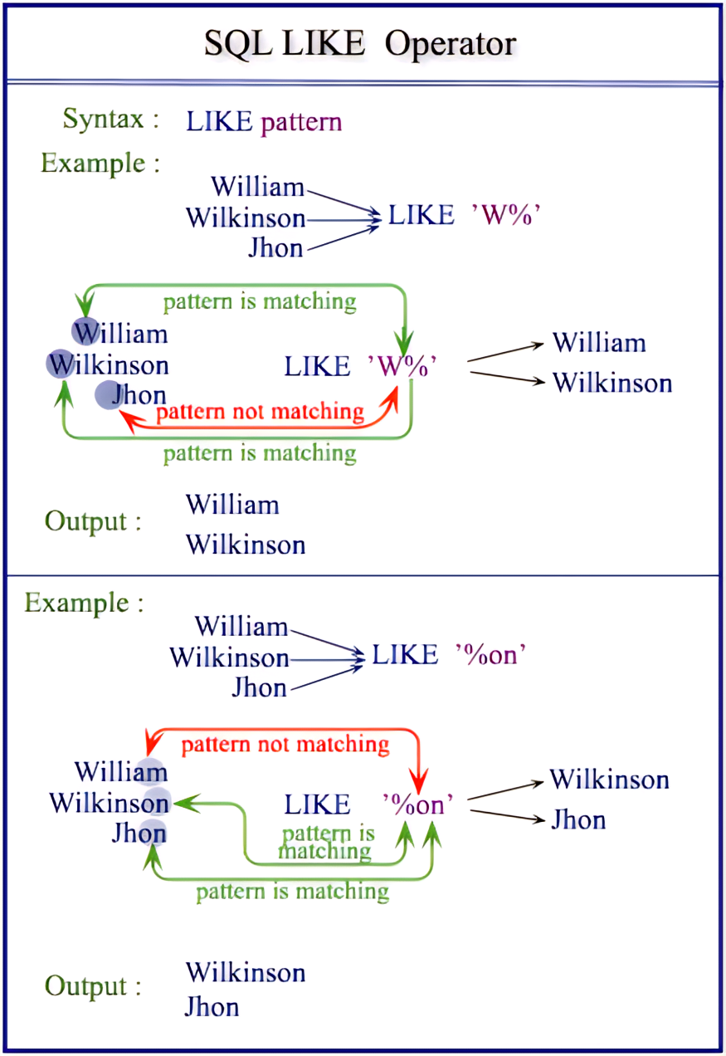
用LIKE操作符
用LIKE操作符从一个字符串中进行匹配查询
% 代表0到多个字符匹配
_ 代表单个字符匹配
SELECT ename
FROM emp
WHERE ename LIKE ‘W%'
SELECT ename
FROM emp
WHERE ename LIKE ‘%on'
Notes:
The LIKE Operator
You may not always know the exact value to search for. You can select rows that match a character pattern by using the LIKE operator. The character pattern matching operation is referred to as a wildcard search. Two symbols can be used to construct the search string.
The SELECT statement above returns the employee name from the EMP table for any employee whose name begins with an “S.” Note the uppercase “S.” Names beginning with an “s” will not be returned.
The LIKE operator can be used as a shortcut for some BETWEEN comparisons. The following example displays names and hiredates of all employees who joined between January 1981 and December 1981.
SQL> SELECT ename, hiredate
2 FROM emp
3 WHERE hiredate LIKE '%81';

Slide 97
用LIKE操作符
可以组合模式匹配字符
SELECT ename
FROM emp
WHERE ename LIKE '_A%'
ENAME
----------
JAMES
WARD
Notes:
Combining Wildcard Characters
The % and _ symbols can be used in any combination with literal characters. The example on the slide displays the names of all employees whose name has an “A” as the second character.
The ESCAPE Option
When you need to have an exact match for the actual "%" and "_" characters, use the ESCAPE option. This option specifies what the ESCAPE character is. To display the names of employees whose name contains "A_B", use the following SQL statement:
The ESCAPE option identifies the backlash (\) as the escape character. In the pattern, the escape character precedes the underscore (_). This causes the Oracle Server to interpret the underscore literally.
SQL> SELECT ename
2 FROM emp
3 WHERE ename LIKE '%A\_%B' ESCAPE '\';

Slide 98
转义符
可以使用转义标识符搜索带“%”或“_”的内容
查询DB_Design课程的课程号和学分
查询DB_Design课程的课程号和学分。
SELECT Cno，Ccredit FROM Course
WHERE Cname LIKE 'DB\_Design' ESCAPE '\'
查询以"DB_"开头，且倒数第3个字符为 i的课程的详细情况
SELECT * FROM Course
WHERE Cname LIKE 'DB\_%i_ _' ESCAPE ' \ '

Slide 99
IS NULL 操作符
使用谓词 IS NULL 或 IS NOT NULL
“IS NULL” 不能用 “= NULL” 代替
SELECT ename, mgr
FROM emp
WHERE mgr IS NULL
ENAME MGR
---------- ---------
KING
Notes:
The IS NULL Operator
The IS NULL operator tests for values that are null. A null value means the value is unavailable, unassigned, unknown, or inapplicable. Therefore, you cannot test with (=) because a null value cannot be equal or unequal to any value. The example above retrieves the name and manager of all employees who do not have a manager.
For example, to display name, job title, and commission for all employees who are not entitled to get a commission, use the following SQL statement:
ENAME JOB COMM
-------- ----------- ------
KING PRESIDENT
BLAKE MANAGER
CLARK MANAGER
...

Slide 100
用AND操作符
逻辑操作符
AND
OR
NOT
SELECT empno, ename, job, sal
FROM emp
WHERE sal>=1100
AND job='CLERK'
EMPNO ENAME JOB SAL
----- ---------- --------- ---------
7876 ADAMS CLERK 1100
7934 MILLER CLERK 1300
Notes:
The AND Operator
In the example, both conditions must be true for any record to be selected. Therefore, an employee who has a job title of CLERK and earns more than $1100 will be selected.
All character searches are case sensitive. No rows are returned if CLERK is not in uppercase. Character strings must be enclosed in quotation marks.
AND Truth Table
The following table shows the results of combining two expressions with AND:
Class Management Note
Demo: l2and.sql
Purpose: To illustrate using the AND operator.

Slide 101
用 OR 操作符
SELECT empno, ename, job, sal
FROM emp
WHERE sal>=1100
OR job='CLERK'
EMPNO ENAME JOB SAL
--------- ---------- --------- ---------
7839 KING PRESIDENT 5000
7698 BLAKE MANAGER 2850
7782 CLARK MANAGER 2450
7566 JONES MANAGER 2975
7654 MARTIN SALESMAN 1250
...
14 rows selected.
Notes:
The OR Operator
In the example, either condition can be true for any record to be selected. Therefore, an employee who has a job title of CLERK or earns more than $1100 will be selected.
OR Truth Table
The following table shows the results of combining two expressions with OR:
Class Management Note
Demo: l2or.sql
Purpose: To illustrate using the OR operator.

Slide 102
用 NOT 操作符
SELECT ename, job
FROM emp
WHERE job NOT IN ('CLERK','MANAGER','ANALYST')
ENAME JOB
---------- ---------
KING PRESIDENT
MARTIN SALESMAN
ALLEN SALESMAN
TURNER SALESMAN
WARD SALESMAN
Notes:
The NOT Operator
The example above displays name and job title of all the employees whose job title is not CLERK, MANAGER, or ANALYST.
NOT Truth Table
The following table shows the result of applying the NOT operator to a condition:
Note: The NOT operator can also be used with other SQL operators such as BETWEEN, LIKE, and NULL.
... WHERE NOT job IN ('CLERK', 'ANALYST')
... WHERE sal NOT BETWEEN 1000 AND 1500
... WHERE ename NOT LIKE '%A%'
... WHERE comm IS NOT NULL

Slide 103
优先级
优先级规则
优先级 | 操作符
1 | 比较运算符
2 | NOT
3 | AND
4 | OR

Slide 104
优先级规则
SELECT ename, job, sal
FROM emp
WHERE job='SALESMAN'
OR job='PRESIDENT'
AND sal>1500
ENAME JOB SAL
---------- --------- ---------
KING PRESIDENT 5000
MARTIN SALESMAN 1250
ALLEN SALESMAN 1600
TURNER SALESMAN 1500
WARD SALESMAN 1250
Notes:
Example of Precedence of AND Operator
In the example, there are two conditions:
The first condition is that job is PRESIDENT and salary is greater than 1500.
The second condition is that job is SALESMAN.
Therefore, the SELECT statement reads as follows:
“Select the row if an employee is a PRESIDENT and earns more than $1500 or if the employee is a SALESMAN.”
Class Management Note
Demo: l2sal1.sql
Purpose: To illustrate the rules of precedence.

Slide 105
用括弧优先级
SELECT ename, job, sal
FROM emp
WHERE (job='SALESMAN'
OR job='PRESIDENT')
AND sal>1500
ENAME JOB SAL
---------- --------- ---------
KING PRESIDENT 5000
ALLEN SALESMAN 1600
Notes:
Using Parentheses
In the example, there are two conditions:
The first condition is that job is PRESIDENT or SALESMAN.
The second condition is that salary is greater than 1500.
Therefore, the SELECT statement reads as follows:
“Select the row if an employee is a PRESIDENT or a SALESMAN and if the employee earns more than $1500.”
Class Management Note
Demo: l2sal2.sql
Purpose: To illustrate the rules of precedence.

Slide 106
结果排序ORDER BY
行排序用ORDER BY
ASC: 升序排列, 排序如果没有指定，默认升序排列
DESC: 降序排列
SELECT ename, job, deptno, hiredate
FROM emp
ORDER BY hiredate
ENAME JOB DEPTNO HIREDATE
---------- --------- --------- ---------
SMITH CLERK 20 80-12-17
ALLEN SALESMAN 30 81-02-20
...
14 rows selected.
Notes:
The ORDER BY Clause
The order of rows returned in a query result is undefined. The ORDER BY clause can be used to sort the rows. If used, you must place the ORDER BY clause last. You can specify an expression or an alias to sort.
Syntax
SELECT expr
FROM table
[WHERE condition(s)]
[ORDER BY {column, expr} [ASC|DESC]];
where: ORDER BY specifies the order in which the retrieved rows are displayed.
ASC orders the rows in ascending order. This is the default order.
DESC orders the rows in descending order.
If the ORDER BY clause is not used, the sort order is undefined, and the OracleServer may not fetch rows in the same order for the same query twice. Use the ORDER BY clause to display the rows in a specific order.

Slide 107
降序排序
SELECT ename, job, deptno, hiredate
FROM emp
ORDER BY hiredate DESC
ENAME JOB DEPTNO HIREDATE
---------- --------- --------- ---------
ADAMS CLERK 20 83-01-12
SCOTT ANALYST 20 82-02-09
MILLER CLERK 10 82-01-23
JAMES CLERK 30 81-12-03
FORD ANALYST 20 81-12-03
KING PRESIDENT 10 81-11-17
MARTIN SALESMAN 30 81-09-28
...
14 rows selected.
Notes:
Default Ordering of Data
The default sort order is ascending:
Numeric values are displayed with the lowest values first¾for example, 1–999.
Date values are displayed with the earliest value first¾for example, 01-JAN-92 before 01-JAN-95.
Character values are displayed in alphabetical order¾for example, A first and Z last.
Null values are displayed last for ascending sequences and first for descending sequences.
Reversing the Default Order
To reverse the order in which rows are displayed, specify the keyword DESC after the column name in the ORDER BY clause. The example above sorts the result by the most recently hired employee.

Slide 108
别名列的排序
SELECT empno, ename, sal*12 annsal
FROM emp
ORDER BY annsal
EMPNO ENAME ANNSAL
--------- ---------- ---------
7369 SMITH 9600
7900 JAMES 11400
7876 ADAMS 13200
7654 MARTIN 15000
7521 WARD 15000
7934 MILLER 15600
7844 TURNER 18000
...
14 rows selected.
Notes:
Sorting By Column Aliases
You can use a column alias in the ORDER BY clause. The above example sorts the data by annual salary.

Slide 109
多个列的排序
结果输出是 ORDER BY 排序字段顺序显示
SELECT ename, deptno, sal
FROM emp
ORDER BY deptno, sal DESC
ENAME DEPTNO SAL
---------- --------- ---------
KING 10 5000
CLARK 10 2450
MILLER 10 1300
FORD 20 3000
...
14 rows selected.
Notes:
Sorting by Multiple Columns
You can sort query results by more than one column. The sort limit is the number of columns in the given table.
In the ORDER BY clause, specify the columns, and separate the column names using commas. If you want to reverse the order of a column, specify DESC after its name. You can order by columns that are not included in the SELECT clause.
Example
Display name and salary of all employees. Order the result by department number and then descending order by salary.
Class Management Note
Show that the DEPTNO column is sorted in ascending order and the SAL column in descending order.

Slide 110
SQL 函数
输入
函数
输出
参数 1
参数 2
结果
参数 n
Notes:
SQL Functions
Functions are a very powerful feature of SQL and can be used to do the following:
Perform calculations on data
Modify individual data items
Manipulate output for groups of rows
Format dates and numbers for display
Convert column datatypes
SQL functions accept argument(s) and return value(s).
Note: Most of the functions described in this lesson are specific to Oracle’s version of SQL.
Class Management Note
This lesson does not discuss all functions in great detail. Present the most common functions without a long explanation.

Slide 111
用字符串函数(下标从1)
SELECT ename, ename + job, LEN(ename),
CHARINDEX('A',ename)
FROM emp
WHERE
SUBSTRING(job,1,5) = 'SALES'
ENAME ENAME+JOB LEN(ENAME) CHARINDEX(ENAME,'A')
---------- ------------------- ------------- ----------------
MARTIN MARTINSALESMAN 6 2
ALLEN ALLENSALESMAN 5 1
TURNER TURNERSALESMAN 6 0
WARD WARDSALESMAN 4 2
Notes:
Character Manipulation Functions (continued)
The above example displays employee name and job joined together, length of the employee name, and the numeric position of the letter A in the employee name, for all employees who are in sales.
Example
Modify the above SQL statement to display the data for those employees whose names end with an N.
ENAME CONCAT(ENAME,JOB) LENGTH(ENAME) INSTR(ENAME,'A')
-------- ------------------- ------------- ----------------
MARTIN MARTINSALESMAN 6 2
ALLEN ALLENSALESMAN 5 1
SQL> SELECT ename, CONCAT(ename, job), LENGTH(ename), INSTR(ename, 'A')
2 FROM emp
3 WHERE SUBSTR(ename, -1, 1) = 'N';

Slide 112
多表连接运算
EMP
DEPT
EMPNO ENAME ... DEPTNO ------ ----- ... ------ 7839 KING ... 10
7698 BLAKE ... 30
...
7934 MILLER ... 10
DEPTNO DNAME LOC
------ ---------- --------
10 ACCOUNTING NEW YORK
20 RESEARCH DALLAS
30 SALES CHICAGO
40 OPERATIONS BOSTON
EMPNO DEPTNO LOC
----- ------- --------
7839 10 NEW YORK
7698 30 CHICAGO
7782 10 NEW YORK
7566 20 DALLAS
7654 30 CHICAGO
……
Notes:
Data from Multiple Tables
Sometimes you need to use data from more than one table. In the example above, the report displays data from two separate tables.
EMPNO exists in the EMP table.
DEPTNO exists in both the EMP and DEPT tables.
LOC exists in DEPT table.
To produce the report, you need to link EMP and DEPT tables and access data from both of them.
Class Management Note
In the slide above, the DEPTNO column can come from either the EMP or the DEPT table.

Slide 113
JOIN连接
用连接从多个表中查询数据
写JOIN连接条件在WHERE语句中
相同的列名在多个表中出现时，需要采用加表名进行区分。
SELECT table1.column, table2.column
FROM table1, table2
WHERE table1.column1 = table2.column2
Notes:
Defining Joins
When data from more than one table in the database is required, a join condition is used. Rows in one table can be joined to rows in another table according to common values existing in corresponding columns, that is usually, primary and foreign key columns.
To display data from two or more related tables, write a simple join condition in the WHERE clause. In the syntax:
table.column denotes the table and column from which data is retrieved.
table1.column1 = is the condition that joins (or relates) the tables together. table2.column2
Guidelines
When writing a SELECT statement that joins tables, precede the column name with the table name for clarity and to enhance database access.
If the same column name appears in more than one table, the column name must be prefixed with the table name.
To join n tables together, you need a minimum of (n-1) join conditions. Therefore, to join four tables, a minimum of three joins are required. This rule may not apply if your table has a concatenated primary key, in which case more than one column is required to uniquely identify each row.
For more information, see
Oracle Server SQL Reference Manual, Release 8.0, “SELECT.”

Slide 114
笛卡尔乘积
笛卡尔积是在：
省略了连接条件
连接条件无效
第一个表中的所有行都连接到第二个表中的所有行
为了避免笛卡尔积，总是在WHERE子句中包含有效的连接条件
Notes:
Cartesian Product
When a join condition is invalid or omitted completely, the result is a Cartesian product in which all combinations of rows will be displayed. All rows in the first table are joined to all rows in the second table.
A Cartesian product tends to generate a large number of rows, and its result is rarely useful. You should always include a valid join condition in a WHERE clause, unless you have a specific need to combine all rows from all tables.

Slide 115
创建一个笛卡尔积
EMP (14 rows)
DEPT (4 rows)
EMPNO ENAME ... DEPTNO ------ ----- ... ------ 7839 KING ... 10
7698 BLAKE ... 30
...
7934 MILLER ... 10
DEPTNO DNAME LOC
------ ---------- --------
10 ACCOUNTING NEW YORK
20 RESEARCH DALLAS
30 SALES CHICAGO
40 OPERATIONS BOSTON
ENAME DNAME
------ ----------
KING ACCOUNTING
BLAKE ACCOUNTING
...
KING RESEARCH
BLAKE RESEARCH
...
56 rows selected.
笛卡尔积 14*4=56 行
Notes:
Cartesian Product (continued)
A Cartesian product is generated if a join condition is omitted. The example on the slide displays employee name and department name from EMP and DEPT tables. Because no WHERE clause has been specified, all rows (14 rows) from the EMP table are joined with all rows (4 rows) in the DEPT table, thereby generating 56 rows in the output.
Class Management Note
Demo: l4cart.sql
Purpose: To illustrate executing a cartesian product.
SQL> SELECT ename, dname
2 FROM emp, dept;
ENAME DNAME
---------- --------------
KING ACCOUNTING
BLAKE ACCOUNTING
...
KING RESEARCH
BLAKE RESEARCH
...
56 rows selected.

Slide 116
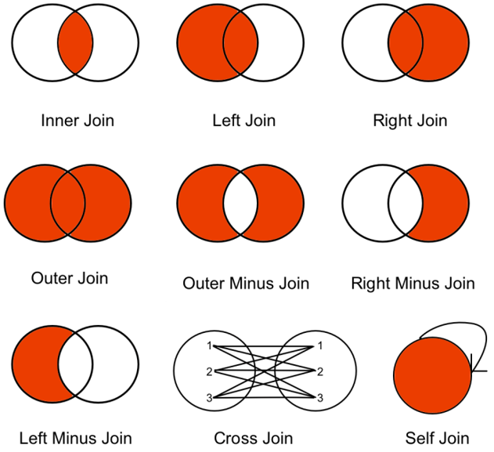
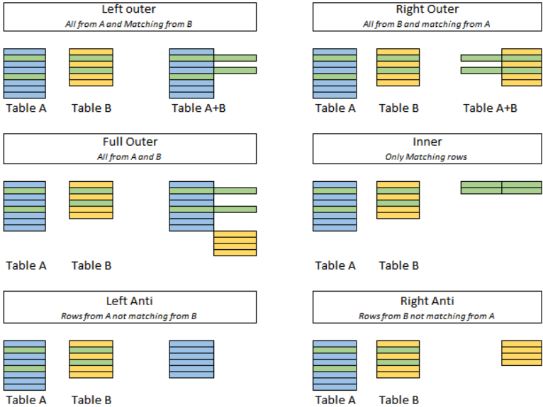
连接类型

Slide 117
内连接类型
相等连接
非对等连接
Notes:
Types of Joins
There are two main types of join conditions:
Equijoins
Non-equijoins
Additional join methods include the following:
Outer joins
Self joins
Set operators
Class Management Note
Do not get into details of all the types of joins. Explain each join one by one as is done in the following slides.

Slide 118
对等连接?
EMP
DEPT
EMPNO ENAME DEPTNO
------ ------- -------
7839 KING 10
7698 BLAKE 30
7782 CLARK 10
7566 JONES 20
7654 MARTIN 30
7499 ALLEN 30
7844 TURNER 30
7900 JAMES 30
7521 WARD 30
7902 FORD 20
7369 SMITH 20
14 rows selected.
DEPTNO DNAME LOC
------- ---------- --------
10 ACCOUNTING NEW YORK
30 SALES CHICAGO
10 ACCOUNTING NEW YORK
20 RESEARCH DALLAS
30 SALES CHICAGO
30 SALES CHICAGO
30 SALES CHICAGO
30 SALES CHICAGO
30 SALES CHICAGO
20 RESEARCH DALLAS
20 RESEARCH DALLAS
14 rows selected.
Primary key
Foreign key
Notes:
Equijoins
To determine the name of an employee’s department, you compare the value in the DEPTNO column in the EMP table with the DEPTNO values in the DEPT table. The relationship between the EMP and DEPT tables is an equijoin¾that is, values in the DEPTNO column on both tables must be equal. Frequently, this type of joins involve primary and foreign key complements.
Note: Equijoins are also called simple joins or inner joins.
Class Management Note
Explain the use of decision matrix for simplifying writing joins. For example, if you want to display the name and department number of all the employees who are in the same department as Smith, you can start by making the following decision tree:
Now, the SQL statement can be easily formulated by looking at the decision matrix. The first column gives the column list in the SELECT statement, the second column gives the tables for the FROM clause, and the third column gives the condition for the WHERE clause.

Slide 119
用对等连接
SELECT emp.empno, emp.ename, emp.deptno, dept.deptno, dept.loc
FROM emp, dept
WHERE emp.deptno=dept.deptno
EMPNO ENAME DEPTNO DEPTNO LOC
----- ------ ------ ------ ---------
7839 KING 10 10 NEW YORK
7698 BLAKE 30 30 CHICAGO
7782 CLARK 10 10 NEW YORK
7566 JONES 20 20 DALLAS
...
14 rows selected.
Notes:
Retrieving Records with Equijoins
In the above example:
The SELECT clause specifies the column names to retrieve:
employee name, employee number, and department number, which are columns in the EMP table
department number, department name, and location, which are columns in the DEPT table
The FROM clause specifies the two tables that the database must access:
EMP table
DEPT table
The WHERE clause specifies how the tables are to be joined:
EMP.DEPTNO=DEPT.DEPTNO
Because the DEPTNO column is common to both tables, it must be prefixed by the table name to avoid ambiguity.

Slide 120
区分模糊的列名
采用加表前缀来区分多个表的列
采用表前缀来提升性能
区分不同表中命名相同别名的列
Notes:
Qualifying Ambiguous Column Names
You need to qualify the names of the columns in the WHERE clause with the table name to avoid ambiguity. Without the table prefixes, the DEPTNO column could be from either the DEPT table or the EMP table. It is necessary to add the table prefix to execute your query.
If there are no common column names between the two tables, there is no need to qualify the columns. However, you will gain improved performance by using the table prefix because you tell the Oracle Server exactly where to go to find columns.
The requirement to qualify ambiguous column names is also applicable to columns that may be ambiguous in other clauses such as SELECT clause or ORDER BY clause.
Class Management Note
Demo: l4loc.sql
Purpose: To illustrate a SELECT clause with no aliases.

Slide 121
用表的别名
用表的别名简化查询
SELECT emp.empno, emp.ename, emp.deptno,
dept.deptno, dept.loc
FROM emp, dept
WHERE emp.deptno=dept.deptno
SELECT e.empno, e.ename, e.deptno,
d.deptno, d.loc
FROM emp e, dept d
WHERE e.deptno=d.deptno
Notes:
Table Aliases
Qualifying column names with table names can be very time consuming, particularly if table names are lengthy. You can use table aliases instead of table names. Just as a column alias gives a column another name, a table alias gives a table another name. Table aliases help to keep SQL code smaller, therefore using less memory.
Notice how table aliases are identified in the FROM clause in the example. The table name is specified in full, followed by a space and then the table alias. The EMP table has been given an alias of E, whereas the DEPT table has an alias of D.
Guidelines
Table aliases can be up to 30 characters in length, but the shorter they are the better.
If a table alias is used for a particular table name in the FROM clause, then that table alias must be substituted for the table name throughout the SELECT statement.
Table aliases should be meaningful.
The table alias is valid only for the current SELECT statement.

Slide 122
连接多个表
CUSTOMER
ORD
NAME CUSTID
----------- ------
JOCKSPORTS 100
TKB SPORT SHOP 101
VOLLYRITE 102
JUST TENNIS 103
K+T SPORTS 105
SHAPE UP 106
WOMENS SPORTS 107
... ...
9 rows selected.
CUSTID ORDID
------- -------
101 610
102 611
104 612
106 601
102 602
106 604
106 605
...
21 rows selected.
ITEM
ORDID ITEMID
------ -------
610 3
611 1
612 1
601 1
602 1
...
64 rows selected.
WHERE CUSTOMER.CUSTID=ORD.CUSTID
and ORD.ORDID=ITEM.ORDID
Notes:
Additional Search Conditions
Sometimes you may need to join more than two tables. For example, to display the name, the orders placed, the item numbers, the total for each item, and the total for each order for customer TKB SPORT SHOP, you will have to join the CUSTOMER, ORD, and ITEM tables.
SQL> SELECT c.name, o.ordid, i.itemid, i.itemtot, o.total
2 FROM customer c, ord o, item i
3 WHERE c.custid = o.custid
4 AND o.ordid = i.ordid
5 AND c.name = 'TKB SPORT SHOP';
NAME ORDID ITEMID ITEMTOT TOTAL
------------ --------- --------- --------- ---------
TKB SPORT SHOP 610 3 58 101.4
TKB SPORT SHOP 610 1 35 101.4
TKB SPORT SHOP 610 2 8.4 101.4

Slide 123
非对等连接
EMP
SALGRADE
EMPNO ENAME SAL
------ ------- ------
7839 KING 5000
7698 BLAKE 2850
7782 CLARK 2450
7566 JONES 2975
7654 MARTIN 1250
7499 ALLEN 1600
7844 TURNER 1500
7900 JAMES 950
...
14 rows selected.
GRADE LOSAL HISAL
----- ----- ------
1 700 1200
2 1201 1400
3 1401 2000
4 2001 3000
5 3001 9999
职工薪水等级？
Notes:
Non-Equijoins
The relationship between the EMP table and the SALGRADE table is a non-equijoin, meaning that no column in the EMP table corresponds directly to a column in the SALGRADE table. The relationship between the two tables is that the SAL column in the EMP table is between the LOSAL and HISAL column of the SALGRADE table. The relationship is obtained using an operator other than equal (=).

Slide 124
用非对等连接获取记录
SELECT e.ename, e.sal, s.grade
FROM emp e, salgrade s
WHERE e.sal
BETWEEN s.losal AND s.hisal
ENAME SAL GRADE
---------- --------- ---------
JAMES 950 1
SMITH 800 1
ADAMS 1100 1
...
14 rows selected.
Notes:
Non-Equijoins (continued)
The example above creates a non-equijoin to evaluate an employee’s salary grade. The salary must be between any pair of the low and high salary ranges.
It is important to note that all employees appear exactly once when this query is executed. No employee is repeated in the list. There are two reasons for this:
None of the rows in the salary grade table contain grades that overlap. That is, the salary value for an employee can only lie between the low salary and high salary values of one of the rows in the salary grade table.
All of the employees’ salaries lie within the limits provided by the salary grade table. That is, no employee earns less than the lowest value contained in the LOSAL column or more than the highest value contained in the HISAL column
Note: Other operators such as <= and >= could be used, but BETWEEN is the simplest. Remember to specify the low value first and the high value last when using BETWEEN. Table aliases have been specified for performance reasons, not because of possible ambiguity.

Slide 125
外连接
EMP
DEPT
ENAME DEPTNO ----- ------ KING 10
BLAKE 30
CLARK 10
JONES 20
...
DEPTNO DNAME
------ ----------
10 ACCOUNTING
30 SALES
10 ACCOUNTING
20 RESEARCH
...
40 OPERATIONS
没有员工在OPERATIONS部门
Notes:
Returning Records with No Direct Match with Outer Joins
If a row does not satisfy a join condition, the row will not appear in the query result. For example, in the equijoin condition of EMP and DEPT tables, department OPERATIONS does not appear because no one works in that department.
SQL> SELECT e.ename, e.deptno, d.dname
2 FROM emp e, dept d
3 WHERE e.deptno = d.deptno;
ENAME DEPTNO DNAME
---------- --------- -------------
KING 10 ACCOUNTING
BLAKE 30 SALES
CLARK 10 ACCOUNTING
JONES 20 RESEARCH
...
ALLEN 30 SALES
TURNER 30 SALES
JAMES 30 SALES
...
14 rows selected.

Slide 126
外连接
使用外部连接也可以获取不满足连接条件的行
SELECT table1.column, table2.column
FROM table1 LEFT OUTER JOIN table2
ON table1.column = table2.column
SELECT table1.column, table2.column
FROM table1 RIGHT OUTER JOIN table2
ON table1.column table2.column
Notes:
Returning Records with No Direct Match with Outer Joins
The missing row(s) can be returned if an outer join operator is used in the join condition. The operator is a plus sign enclosed in parentheses (+), and it is placed on the “side” of the join that is deficient in information. This operator has the effect of creating one or more null rows, to which one or more rows from the nondeficient table can be joined.
In the syntax:
table1.column = is the condition that joins (or relates) the tables together. table2.column (+) is the outer join symbol; it can be placed on either side of the WHERE clause condition, but not on both sides. Place the outer join symbol following the name of the column in the table without the matching rows.
Class Management Note
Demo: l4ejoin.sql
Purpose: To illustrate an equijoin leading to an outer join.

Slide 127
外连接举例
SELECT emp.ename, dept.deptno, dept.dname
FROM emp right outer join dept
ON emp.deptno = dept.deptno
ORDER BY emp.deptno
ENAME DEPTNO DNAME
---------- --------- -------------
KING 10 ACCOUNTING
CLARK 10 ACCOUNTING
...
40 OPERATIONS
15 rows selected.
Notes:
Returning Records with No Direct Match with Outer Joins (continued)
The example above displays numbers and names for all the departments. The OPERATIONS department, which does not have any employees, is also displayed.
Outer Join Restrictions
The outer join operator can appear only on one side of the expression—the side that has information missing. It returns those rows from one table that have no direct match in the other table.
A condition involving an outer join cannot use the IN operator or be linked to another condition by the OR operator.
Class Management Note
Demo: l4ojoin.sql
Purpose: To illustrate an outer join.

Slide 128
自身连接
请找出员工的主管信息？
EMP (WORKER)
EMP (MANAGER)
EMPNO ENAME MGR ----- ------ ---- 7839 KING
7698 BLAKE 7839
7782 CLARK 7839
7566 JONES 7839
7654 MARTIN 7698
7499 ALLEN 7698
EMPNO ENAME ----- --------
7839 KING
7839 KING
7839 KING
7698 BLAKE
7698 BLAKE
在EMP表中的MGR匹配 MANAGER表中的EMPNO
Notes:
Joining a Table to Itself
Sometimes you need to join a table to itself. To find the name of each employee’s manager you need to join the EMP table to itself. For example, to find the name of Blake’s manager, you need to:
Find Blake in the EMP table by looking at the ENAME column.
Find the manager number for Blake by looking at the MGR column. Blake’s manager number is 7839.
Find the name of the manager with EMPNO 7839 by looking at the ENAME column. King’s employee number is 7839. So, King is Blake’s manager.
In this process, you look in the table twice. The first time you look in the table to find Blake in the ENAME column and MGR value of 7839. The second time you look in the EMPNO column to find 7839 and the ENAME column to find King.
Class Management Note
Show the data from the EMP table and point out how each manager is also an employee.

Slide 129
自身连接
SELECT worker.ename+' works for '+manager.ename
FROM emp worker, emp manager
WHERE worker.mgr = manager.empno
WORKER.ENAME+'WORKSFOR'+MANAG
-------------------------------
BLAKE works for KING
CLARK works for KING
JONES works for KING
MARTIN works for BLAKE
...
13 rows selected.
Notes:
Joining a Table to Itself (continued)
The above example joins the EMP table to itself. To simulate two tables in the FROM clause, there are two aliases, namely WORKER and MANAGER, for the same table, EMP.
In this example, the WHERE clause contains the join that means “where a worker’s manager number matches the employee number for the manager.”
Class Management Note
Point out the following to the students:
The column heading in the result of the above query seems meaningless. A meaningful column alias should have been used instead.
There are only 13 rows in the output, but there are 14 rows in the EMP table. This occurs because employee King, who is the president, does not have a manager.

Slide 130
什么是分组?
EMP
DEPTNO SAL
--------- ---------
10 2450
10 5000
10 1300
20 800
20 1100
20 3000
20 3000
20 2975
30 1600
30 2850
30 1250
30 950
30 1500
30 1250
MAX(SAL)
---------
5000
“EMP表中的最高薪水”
Notes:
Group Functions
Unlike single-row functions, group functions operate on sets of rows to give one result per group. These sets may be the whole table or the table split into groups.

Slide 131
分组函数(自动将函数名作为列名)
AVG、COUNT、MAX、MIN、STDEV、SUM ……
SELECT column, group_function(column)
FROM table
[WHERE condition]
[ORDER BY column]
Notes:
Group Functions (continued)
Each of the functions accepts an argument. The following table identifies the options you can use in the syntax:

Slide 132
AVG 、SUM函数
可以对数值类型数据用AVG、SUM函数
SELECT AVG(sal), MAX(sal),
MIN(sal), SUM(sal)
FROM emp
WHERE job LIKE 'SALES%'
AVG(SAL) MAX(SAL) MIN(SAL) SUM(SAL)
-------- --------- --------- ---------
1400 1600 1250 5600
Notes:
Group Functions
You can use AVG, SUM, MIN, and MAX functions against columns that can store numeric data. The example above displays the average, highest, lowest, and sum of monthly salaries for all salesmen.

Slide 133
MIN and MAX函数
可以对任何数据类型用MIN、MAX函数
SELECT MIN(hiredate), MAX(hiredate)
FROM emp
MIN(HIRED MAX(HIRED
--------- ---------
80-12-17 83-01-12
Notes:
Group Functions (continued)
You can use MAX and MIN functions for any datatype. The example above displays the most junior and most senior employee.
The example below displays the employee name that is first and the employee name that is the last in an alphabetized list of all employees.
Note: AVG, SUM, VARIANCE, and STDDEV functions can be used only with numeric datatypes.
SQL> SELECT MIN(ename), MAX(ename)
2 FROM emp;
MIN(ENAME) MAX(ENAME)
---------- ----------
ADAMS WARD

Slide 134
COUNT函数
COUNT(*) 返回满足条件的记录数。
SELECT COUNT(*)
FROM emp
WHERE deptno = 30
COUNT(*)
---------
6
Notes:
The COUNT Function
The COUNT function has two formats:
COUNT(*)
COUNT(expr)
COUNT(*) returns the number of rows in a table, including duplicate rows and rows containing null values.
In contrast, COUNT(expr) returns the number of nonnull rows in the column identified by expr.
The example above displays the number of employees in department 30.
Class Management Note
Demo: l5count1.sql, l5count2.sql
Purpose: To illustrate using the COUNT(*) and COUNT(expr) functions.

Slide 135
COUNT函数
COUNT(表达式) 返回非空行的计数
SELECT COUNT(comm)
FROM emp
WHERE deptno = 30
COUNT(COMM)
-----------
4
Notes:
The COUNT Function (continued)
The example above displays the number of employees in department 30 who can earn a commission. Notice that the result gives the total number of rows to be four because two employees in department 30 cannot earn a commission and contain a null value in the COMM column.
Example
Display the number of departments in the EMP table.
Display the number of distinct departments in the EMP table.
SQL> SELECT COUNT(deptno)
2 FROM emp;
COUNT(DEPTNO)
-------------
14
COUNT(DISTINCT(DEPTNO))
-----------------------
3

Slide 136
在分组函数中的NULL值
分组函数忽略NULL值
SELECT AVG(comm)
FROM emp
AVG(COMM)
---------
550
Notes:
Group Functions and Null Values
All group functions except COUNT (*) ignore null values in the column. In the above example, the average is calculated based only on the rows in the table where a valid value is stored in the COMM column. The average is calculated as total commission being paid to all employees divided by the number of employees receiving commission (4).

Slide 137
创建分组数据
EMP
DEPTNO SAL
--------- ---------
10 2450
10 5000
10 1300
20 800
20 1100
20 3000
20 3000
20 2975
30 1600
30 2850
30 1250
30 950
30 1500
30 1250
2916.6667
DEPTNO AVG(SAL)
------- ---------
10 2916.6667
20 2175
30 1566.6667
计算每个部门的平均薪水
2175
1566.6667
Notes:
Groups of Data
Until now, all group functions have treated the table as one large group of information. At times, you need to divide the table of information into smaller groups. This can be done by using the GROUP BY clause.

Slide 138
GROUP BY 语句
将表中的数据分成小组采用GROUP BY语句
SELECT column, group_function(column)
FROM table
[WHERE condition]
[GROUP BY group_by_expression]
[ORDER BY column]
Notes:
The GROUP BY Clause
You can use the GROUP BY clause to divide the rows in a table into groups. You can then use the group functions to return summary information for each group.
In the syntax:
group_by_expression specifies columns whose values determine the basis for grouping rows.
Guidelines
If you include a group function in a SELECT clause, you cannot select individual results as well unless the individual column appears in the GROUP BY clause. You will receive an error message if you fail to include the column list.
Using a WHERE clause, you can preexclude rows before dividing them into groups.
You must include the columns in the GROUP BY clause.
You cannot use the column alias in the GROUP BY clause.
By default, rows are sorted by ascending order of the columns included in the GROUP BY list. You can override this by using the ORDER BY clause.

Slide 139
GROUP BY 语句
不在分组函数中的列必须在GROUP BY语句中出现。???
SELECT deptno, AVG(sal)
FROM emp
GROUP BY deptno
DEPTNO AVG(SAL)
--------- ---------
10 2916.6667
20 2175
30 1566.6667
Notes:
The GROUP BY Clause (continued)
When using the GROUP BY clause, make sure that all columns in the SELECT list that are not in the group functions are included in the GROUP BY clause. The above example displays the department number and the average salary for each department. Here is how the SELECT statement above, containing a GROUP BY clause, is evaluated:
The SELECT clause specifies the columns to be retrieved:
Department number column in the EMP table
The average of all the salaries in the group you specified in the GROUP BY clause
The FROM clause specifies the tables that the database must access: the EMP table.
The WHERE clause specifies the rows to be retrieved. Since there is no WHERE clause, by default all rows are retrieved.
The GROUP BY clause specifies how the rows should be grouped. The rows are being grouped by department number, so the AVG function that is being applied to the salary column will calculate the average salary for each department.

Slide 140
GROUP BY语句
在GROUP BY中的列不一定出现在SELECT语句中。
SELECT AVG(sal) sal_avg
FROM emp
GROUP BY deptno
SAL_AVG
---------
2916.6667
2175
1566.6667
Notes:
The GROUP BY Clause (continued)
The GROUP BY column does not have to be in the SELECT clause. For example, the above SELECT statement displays the average salaries for each department without displaying the respective department numbers. However, without the department numbers, the results do not look meaningful.
You can use the group function in the ORDER BY clause.
Class Management Note
Demonstrate the query with and without the DEPTNO in the SELECT statement.
DEPTNO AVG(SAL)
---------- ------------
30 1566.6667
20 2175
10 2916.6667

Slide 141
对多个列进行分组
DEPTNO JOB SAL
--------- --------- ---------
10 MANAGER 2450
10 PRESIDENT 5000
10 CLERK 1300
20 CLERK 800
20 CLERK 1100
20 ANALYST 3000
20 ANALYST 3000
20 MANAGER 2975
30 SALESMAN 1600
30 MANAGER 2850
30 SALESMAN 1250
30 CLERK 950
30 SALESMAN 1500
30 SALESMAN 1250
EMP
DEPTNO
--------
10
10
10
20
20
20
30
30
30
JOB SUM(SAL)
--------- ---------
CLERK 1300
MANAGER 2450
PRESIDENT 5000
ANALYST 6000
CLERK 1900
MANAGER 2975
CLERK 950
MANAGER 2850
SALESMAN 5600
按照部门汇总每个角色的总薪水
Notes:
Groups Within Groups
Sometimes there is a need to see results for groups within groups. The slide above shows a report that displays the total salary being paid to each job title, within each department.
The EMP table is grouped first by department number and then within that grouping it is grouped by job title. For example, the two clerks in department 20 are grouped together and a single result (total salary) is produced for all salesmen within the group.
Class Management Note
Demo: l5order1.sql,l5order2.sql
Purpose: To illustrate ordering columns that are grouped by DEPTNO first, and ordering columns that are grouped by JOB first.

Slide 142
对多个列进行分组
SELECT deptno, job, sum(sal)
FROM emp
GROUP BY deptno, job
DEPTNO JOB SUM(SAL)
--------- --------- ---------
10 CLERK 1300
10 MANAGER 2450
10 PRESIDENT 5000
20 ANALYST 6000
20 CLERK 1900
...
9 rows selected.
Notes:
Groups Within Groups (continued)
You can return summary results for groups and subgroups by listing more than one GROUP BY column. You can determine the default sort order of the results by the order of the columns in the GROUP BY clause. Here is how the SELECT statement above, containing a GROUP BY clause, is evaluated:
The SELECT clause specifies the column to be retrieved:
Department number in the EMP table
Job title in the EMP table
The sum of all the salaries in the group you specified in the GROUP BY clause
The FROM clause specifies the tables that the database must access: the EMP table.
The GROUP BY clause specifies how you must group the rows:
First, the rows are grouped by department number.
Second, within the department number groups, the rows are grouped by job title.
So the SUM function is being applied to the salary column for all job titles within each department number group.

Slide 143
不合法的Group函数应用
不在聚合函数中的任何列必须在GROUP BY 语句中
SQL> SELECT deptno, COUNT(ename)
FROM emp
SELECT deptno, COUNT(ename)
列 ‘emp.DEPTNO’ 在选择列表中无效，因为该列未包含在聚合函数
中，并且没有 GROUP BY 子句。 ????
Column missing in the GROUP BY clause
Notes:
Illegal Queries Using Group Functions
Whenever you use a mixture of individual items (DEPTNO) and group functions (COUNT) in the same SELECT statement, you must include a GROUP BY clause that specifies the individual items (in this case, DEPTNO). If the GROUP BY clause is missing, then the error message “not a single-group group function” appears and an asterisk (*) points to the offending column. You can correct the above error by adding the GROUP BY clause.
Any column or expression in the SELECT list that is not an aggregate function must be in the GROUP BY clause.
Class Management Note
Demo: l5error.sql
Purpose: To illustrate executing a SELECT statement with no GROUP BY clause.
SQL> SELECT deptno, COUNT(ename)
2 FROM emp
3 GROUP BY deptno;
DEPTNO COUNT(ENAME)
---------- -----------
10 3
20 5
30 6

Slide 144
不合法的Group函数应用
不能用WHERE语句限制分组内容的输出
可以采用HAVING语句进行限制
SELECT deptno, AVG(sal)
FROM emp
WHERE AVG(sal) > 2000
GROUP BY deptno
Cannot use the WHERE clause
to restrict groups
WHERE AVG(sal) > 2000
聚合不应出现在 WHERE 子句中，除非该聚合位于 HAVING 子句或
选择列表所包含的子查询中，并且要对其进行聚合的列是外部引用。
Notes:
Illegal Queries Using Group Functions (continued)
The WHERE clause cannot be used to restrict groups. The above SELECT statement results in an error because it uses the WHERE clause to restrict the display of average salaries of those departments that have an average salary of greater than $2000.
You can correct the above error by using the HAVING clause to restrict groups.
SQL> SELECT deptno, AVG(sal)
2 FROM emp
3 GROUP BY deptno
4 HAVING AVG(sal) > 2000;

Slide 145
对分组结果条件输出
DEPTNO SAL
--------- ---------
10 2450
10 5000
10 1300
20 800
20 1100
20 3000
20 3000
20 2975
30 1600
30 2850
30 1250
30 950
30 1500
30 1250
EMP
5000
DEPTNO MAX(SAL)
--------- ---------
10 5000
20 3000
3000
求部门最高薪水超过2900的信息
2850
Notes:
Restricting Group Results
In the same way that you use the WHERE clause to restrict the rows that you select, you use the HAVING clause to restrict groups. To find the maximum salary of each department, but show only the departments that have a maximum salary of more than $2900, you need to do the following two things:
1. Find the average salary for each department by grouping by department number.
2. Restrict the groups to those departments with a maximum salary greater than $2900.

Slide 146
HAVING语句
用 HAVING 限制组的输出
行必须分组
必须应用分组函数
显示匹配 HAVING条件的信息
SELECT column, group_function
FROM table
[WHERE condition]
[GROUP BY group_by_expression]
[HAVING group_condition]
[ORDER BY column]
Notes:
The HAVING Clause
You use the HAVING clause to specify which groups are to be displayed. Therefore, you further restrict the groups on the basis of aggregate information.
In the syntax:
group_condition restricts the groups of rows returned to those groups for which the specified condition is TRUE.
The Oracle Server performs the following steps when you use the HAVING clause:
Rows are grouped.
The group function is applied to the group.
The groups that match the criteria in the HAVING clause are displayed.
The HAVING clause can precede the GROUP BY clause, but it is recommended that you place the GROUP BY clause first because it is more logical. Groups are formed and group functions are calculated before the HAVING clause is applied to the groups in the SELECT list.

Slide 147
HAVING语句举例
求部门最高薪水超过2900的信息
SELECT deptno, max(sal)
FROM emp
GROUP BY deptno
HAVING max(sal)>2900
DEPTNO MAX(SAL)
--------- ---------
10 5000
20 3000
Notes:
The HAVING Clause (continued)
The above example displays department numbers and maximum salary for those departments whose maximum salary is greater than $2900.
You can use the GROUP BY clause without using a group function in the SELECT list.
If you restrict rows based on the result of a group function, you must have a GROUP BY clause as well as the HAVING clause.
The following example displays the department numbers and average salary for those departments whose minimum salary is greater than $2900.
SQL> SELECT deptno, AVG(sal)
2 FROM emp
3 GROUP BY deptno
4 HAVING MAX(sal) > 2900;

Slide 148
HAVING语句举例
查询有3门以上课程是90分以上的学生的学号及（90分以上的）课程数
SELECT Sno, COUNT(*)
FROM SC
WHERE Grade>=90
GROUP BY Sno
HAVING COUNT(*)>=3
Notes:
The HAVING Clause (continued)
The above example displays department numbers and maximum salary for those departments whose maximum salary is greater than $2900.
You can use the GROUP BY clause without using a group function in the SELECT list.
If you restrict rows based on the result of a group function, you must have a GROUP BY clause as well as the HAVING clause.
The following example displays the department numbers and average salary for those departments whose minimum salary is greater than $2900.
SQL> SELECT deptno, AVG(sal)
2 FROM emp
3 GROUP BY deptno
4 HAVING MAX(sal) > 2900;

Slide 149
HAVING语句
非销售人员按角色汇总工资总额超过5000美元以上的情况
SELECT job, SUM(sal) PAYROLL
FROM emp
WHERE job NOT LIKE 'SALES%'
GROUP BY job
HAVING SUM(sal)>5000
ORDER BY SUM(sal)
JOB PAYROLL
--------- ---------
ANALYST 6000
MANAGER 8275
Notes:
The HAVING Clause (continued)
The above example displays the job title and total monthly salary for each job title with a total payroll exceeding $5000. The example excludes salesmen and sorts the list by the total monthly salary.
Class Management Note
Demo: l5job1.sql, l5job2.sql
Purpose: To illustrate using a WHERE clause to restrict rows by JOB, and using a HAVING clause to restrict groups by SUM(SAL).

Slide 150
嵌套GROUP语句
显示部门平均薪水最高的信息
SELECT max(avg(sal))
FROM emp
GROUP BY deptno
MAX(AVG(SAL))
-------------
2916.6667
select max(salavg) from
(select avg(sal) salavg from emp
group by deptno) table_avg_sal //这里是用别名？？
Notes:
Nesting Group Functions
Group functions can be nested to any depth. The above example displays the maximum average salary.

Slide 151
子查询
谁的薪水超过Jones？
Main Query
?
“谁的薪水超过Jones
Subquery
?
“Jones的薪水是多少?”
Notes:
Using a Subquery to Solve a Problem
Suppose you want to write a query to find out who earns a salary greater than Jones’s salary.
To solve this problem, you need two queries: one query to find what Jones earns and a second query to find who earns more than that amount.
You can solve this problem by combining the two queries, placing one query inside the other query.
An inner query or the subquery returns a value that is used by the outer query or the main query. Using a subquery is equivalent to performing two sequential queries and using the result of the first query as the search value in the second query.

Slide 152
子查询
子查询在主查询之前执行一次
子查询的结果被主查询所用
SELECT select_list
FROM table
WHERE expr operator
(SELECT select_list
FROM table)
Notes:
Subqueries
A subquery is a SELECT statement that is embedded in a clause of another SELECT statement. You can build powerful statements out of simple ones by using subqueries. They can be very useful when you need to select rows from a table with a condition that depends on the data in the table itself.
You can place the subquery in a number of SQL clauses:
WHERE clause
HAVING clause
FROM clause
In the syntax:
operator includes a comparison operator such as >, =, or IN
Note: Comparison operators fall into two classes: single-row operators (>, =, >=, <, <>, <=) and multiple-row operators (IN, ANY, ALL).
The subquery is often referred to as a nested SELECT, sub-SELECT, or inner SELECT statement. The subquery generally executes first, and its output is used to complete the query condition for the main or outer query.
Class Management Note
Additionally, subqueries can be placed in the CREATE VIEW statement, CREATE TABLE statement, UPDATE clause, INTO clause of an INSERT statement, and SET clause of an UPDATE statement.

Slide 153
子查询
SELECT ename
FROM emp
WHERE sal >
(SELECT sal
FROM emp
WHERE empno=7566 or empno = 7934)
2975
ENAME
----------
KING
FORD
SCOTT
Notes:
Using a Subquery
In the slide, the inner query determines the salary of employee 7566. The outer query takes the result of the inner query and uses this result to display all the employees who earn more than this amount.
Class Management Note
Execute the subquery (inner query) on its own first to show the value that the subquery returns. Then execute the outer query using the result returned by the inner query. Finally, execute the entire query (containing the subquery) and show that the result is the same.

Slide 154
子查询
将子查询放入（）内
将子查询放在比较运算符的右边
不能在子查询中增加ORDER BY语句
用单行操作符与单行子查询进行运算
用多行操作符与多行子查询进行运算
Notes:
Guidelines for Using Subqueries
A subquery must be enclosed in parentheses.
A subquery must appear on the right side of the comparison operator.
Subqueries cannot contain an ORDER BY clause. You can have only one ORDER BY clause for a SELECT statement, and if specified it must be the last clause in the main SELECT statement.
Two classes of comparison operators are used in subqueries: single-row operators and multiple-row operators.
Class Management Note
A subquery can execute multiple times in correlated subqueries, which are not included in this course. Students may ask how many subqueries can be written. The Oracle Server imposes no limit on the number of subqueries. The limit is related to the buffer size that the query uses.

Slide 155
子查询的类型
单行子查询
多行子查询
多行多列子查询
Main query
returns
CLERK
Subquery
Main query
returns
CLERK
MANAGER
Subquery
Main query
CLERK 7900 MANAGER 7698
returns
Subquery
Notes:
Types of Subqueries
Single-row subqueries: Queries that return only one row from the inner SELECT statement
Multiple-row subqueries: Queries that return more than one row from the inner SELECT statement
Multiple-column subqueries: Queries that return more than one column from the inner SELECT statement

Slide 156
单行查询
查询结果仅返回一行结果
用单行比较运算符
运算符 | 含义
= | Equal to
> | Greater than
>= | Greater than or equal to
< | Less than
<= | Less than or equal to
<> | Not equal to
Notes:
Single-Row Subqueries
A single-row subquery is one that returns one row from the inner SELECT statement. This type of subquery uses a single-row operator. The slide gives a list of single-row operators.
Example
Display the employees whose job title is the same as that of employee 7369.
ENAME JOB
---------- ---------
JAMES CLERK
SMITH CLERK
ADAMS CLERK
MILLER CLERK
SQL> SELECT ename, job 2 FROM emp 3 WHERE job =
4 (SELECT job 5 FROM emp 6 WHERE empno = 7369);

Slide 157
单行子查询
SELECT ename, job FROM emp
WHERE job =
(SELECT job FROM emp WHERE empno = 7369)
AND sal >
(SELECT sal
FROM emp
WHERE empno = 7876)
CLERK
1100
ENAME JOB
---------- ---------
MILLER CLERK
Notes:
Executing Single-Row Subqueries
A SELECT statement can be considered as a query block. The example above displays employees whose job title is the same as that of employee 7369 and whose salary is greater than that of employee 7876.
The example consists of three query blocks: the outer query and two inner queries. The inner query blocks are executed first, producing the query results: CLERK and 1100, respectively. The outer query block is then processed and uses the values returned by the inner queries to complete its search conditions.
Both the inner queries return single values (CLERK and 1100, respectively), so this SQL statement is called a single-row subquery.
Note: The outer and the inner queries can get data from different tables.

Slide 158
在子查询中用分组函数
SELECT ename, job, sal
FROM emp
WHERE sal =
(SELECT MIN(sal)
FROM emp)
800
ENAME JOB SAL
---------- --------- ---------
SMITH CLERK 800
Notes:
Using Group Functions in a Subquery
You can display data from a main query by using a group function in a subquery to return a single row. The subquery is in parentheses and is placed after the comparison operator.
The example above displays the employee name, job title, and salary of all employees whose salary is equal to the minimum salary. The MIN group function returns a single value (800) to the outer query.

Slide 159
在HAVING语句中用子查询
SELECT deptno, MIN(sal)
FROM emp
GROUP BY deptno
HAVING MIN(sal) >
(SELECT MIN(sal)
FROM emp
WHERE deptno = 20)
800
Notes:
HAVING Clause With Subqueries
You can use subqueries not only in the WHERE clause, but also in the HAVING clause. The Oracle Server executes the subquery, and the results are returned into the main query’s HAVING clause.
The SQL statement on the slide displays all the departments that have a minimum salary greater than that of department 20.
Example
Find the job with the lowest average salary.
DEPTNO MIN(SAL)
--------- ---------
10 1300
30 950
SQL> SELECT job, AVG(sal)
2 FROM emp
3 GROUP BY job
4 HAVING AVG(sal) = (SELECT MIN(AVG(sal))
5 FROM EMP
6 GROUP BY job);

Slide 160
指出下面语句的错误
SELECT empno, ename
FROM emp
WHERE sal =
(SELECT MIN(sal)
FROM emp
GROUP BY deptno)
ERROR:
single-row subquery returns more than one row
Notes:
Errors with Subqueries
One common error with subqueries is more than one row returned for a single-row subquery.
In the SQL statement above, the subquery contains a GROUP BY (deptno) clause, which implies that the subquery will return multiple rows, one for each group it finds. In this case, the result of the subquery will be 800, 1300, and 950.
The outer query takes the results of the subquery (800, 950, 1300) and uses these results in its WHERE clause. The WHERE clause contains an equal (=) operator, a single-row comparison operator expecting only one value. The = operator cannot accept more than one value from the subquery and hence generates the error.
To correct this error, change the = operator to IN.

Slide 161
该语句能正常执行？
在职工信息表中没有SMYTHE的人:
SELECT ename, job
FROM emp
WHERE job =
(SELECT job
FROM emp
WHERE ename='SMYTHE')
Subquery returns no values
no rows selected
Notes:
Problems with Subqueries
A common problem with subqueries is no rows being returned by the inner query.
In the SQL statement above, the subquery contains a WHERE (ename='SMYTHE') clause. Presumably, the intention is to find the employee whose name is Smythe. The statement seems to be correct but selects no rows when executed.
The problem is that Smythe is misspelled. There is no employee named Smythe. So the subquery returns no rows. The outer query takes the results of the subquery (null) and uses these results in its WHERE clause. The outer query finds no employee with a job title equal to null and so returns no rows.

Slide 162
多行子查询
返回超过多行数据
用多行比较运算符
操作符
IN
ANY
ALL
意义
Equal to any member in the list
Compare value to each value returned by the subquery
Compare value to every value returned by the subquery
Notes:
Multiple-Row Subqueries
Subqueries that return more than one row are called multiple-row subqueries. You use a multiple-row operator, instead of a single-row operator, with a multiple row subquery. The multiple-row operator expects one or more values.
Example
Find the employees who earn the same salary as the minimum salary for departments.
The inner query is executed first, producing a query result containing three rows: 800, 950, 1300. The main query block is then processed and uses the values returned by the inner query to complete its search condition. In fact, the main query would look like the following to the Oracle Server:

Slide 163
ANY操作符
SELECT empno, ename, job
FROM emp
WHERE sal < ANY
(SELECT sal
FROM emp
WHERE job = 'CLERK')
AND job <> 'CLERK'
1300
1100
800
950
EMPNO ENAME JOB
--------- ---------- ---------
7654 MARTIN SALESMAN
7521 WARD SALESMAN
Notes:
Multiple-Row Subqueries (continued)
The ANY operator (and its synonym SOME operator) compares a value to each value returned by a subquery. The example above displays employees whose salary is less than any clerk and who are not clerks. The maximum salary that a clerk earns is $1300. The SQL statement displays all the employees who are not clerks but earn less than $1300.
<ANY means less than the maximum. >ANY means more than the minimum. =ANY is equivalent to IN.
Class Management Note
When using SOME or ANY, you often use the DISTINCT keyword to prevent rows from being selected several times.

Slide 164
ALL操作符
SELECT empno, ename, job
FROM emp
WHERE sal > ALL
(SELECT avg(sal)
FROM emp
GROUP BY deptno)
1566.6667
2175
2916.6667
EMPNO ENAME JOB
--------- ---------- ---------
7839 KING PRESIDENT
7566 JONES MANAGER
7902 FORD ANALYST
7788 SCOTT ANALYST
Notes:
Multiple-Row Subqueries (continued)
The ALL operator compares a value to every value returned by a subquery. The example above displays employees whose salary is greater than the average salaries of all the departments. The highest average salary of a department is $2916.66, so the query returns those employees whose salary is greater than $2916.66.
>ALL means more than the maximum and <ALL means less than the minimum.
The NOT operator can be used with IN, ANY, and ALL operators.

Slide 165
EXISTS条件查询
EXISTS：指定一个子查询，检测行的存在。
语法：EXISTS subquery
结果值：如果子查询包含行，则返回TRUE
例子：查找与出版商住在同一城市中的作者
SELECT au_lname, au_fname
FROM authors
WHERE exists
(SELECT 1 FROM publishers
WHERE authors.city = publishers.city)

Slide 166
视图（VIEW）
EMP Table
EMPNO ENAME JOB MGR HIREDATE SAL COMM DEPTNO
----- -------- --------- ---- --------- ------ ----- -------
7839 KING PRESIDENT 17-NOV-81 5000 10
7782 CLARK MANAGER 7839 09-JUN-81 1500 300 10
7934 MILLER CLERK 7782 23-JAN-82 1300 10
7566 JONES MANAGER 7839 02-APR-81 2975 20
7788 SCOTT ANALYST 7566 09-DEC-82 3000 20
7876 ADAMS CLERK 7788 12-JAN-83 1100 20
7369 SMITH CLERK 7902 17-DEC-80 800 20
7902 FORD ANALYST 7566 03-DEC-81 3000 20
7698 BLAKE MANAGER 7839 01-MAY-81 2850 30
7654 MARTIN SALESMAN 7698 28-SEP-81 1250 1400 30
7499 ALLEN SALESMAN 7698 20-FEB-81 1600 300 30
7844 TURNER SALESMAN 7698 08-SEP-81 1500 0 30
7900 JAMES CLERK 7698 03-DEC-81 950 30
7521 WARD SALESMAN 7698 22-FEB-81 1250 500 30
View
EMPNO ENAME JOB
------ -------- -----------
7839 KING PRESIDENT
7782 CLARK MANAGER
7934 MILLER CLERK
Notes:
What Is a View?
You can present logical subsets or combinations of data by creating views of tables. A view is a logical table based on a table or another view. A view contains no data of its own but is like a window through which data from tables can be viewed or changed. The tables on which a view is based are called base tables. The view is stored as a SELECT statement in the data dictionary.

Slide 167
视图的用途
限制数据访问
能够简化用户的操作，使复杂查询简单化
使用户能以多种角度看待同一数据
对重构数据库提供了一定程度的逻辑独立性
对机密数据提供安全保护
Notes:
Advantages of Views
Restrict access to the database because the view can display a selective portion of the database.
Allow users to make simple queries to retrieve the results from complicated queries. For example, views allow users to query information from multiple tables without knowing how to write a join statement.
Provide data independence for ad hoc users and application programs. One view can be used to retrieve data from several tables.
Provide groups of users access to data according to their particular criteria.
For more information, see Oracle Server SQL Reference, Release 8.0, “CREATE VIEW.”

Slide 168
创建视图
嵌入一个子查询在 CREATE VIEW 语句中
子查询可以包含复杂的 SELECT语法
子查询不能包含 ORDER BY 子句
CREATE VIEW viewname
[(alias[, alias]...)]
AS subquery
Notes:
Creating a View
You can create a view by embedding a subquery within the CREATE VIEW statement.
In the syntax:
OR REPLACE recreates the view if it already exists.
FORCE creates the view regardless of whether or not the base tables exist.
NOFORCE creates the view only if the base tables exist. This is the default.
view is the name of the view.
alias specifies names for the expressions selected by the view’s query. The number of aliases must match the number of expressions selected by the view.
subquery is a complete SELECT statement. You can use aliases for the columns in the SELECT list.
WITH CHECK OPTION specifies that only rows accessible to the view can be inserted or updated.
constraint is the name assigned to the CHECK OPTION constraint.
WITH READ ONLY ensures that no DML operations can be performed on this view.

Slide 169
创建视图
创建部门编号为10的职工信息视图。
CREATE VIEW empvu10
AS SELECT empno, ename, job
FROM emp
WHERE deptno = 10
View created.
查看视图定义信息
Sp_help empvu10
Notes:
Creating a View (continued)
The example above creates a view that contains the employee number, name, and job title for all the employees in department 10.
You can display the structure of the view by using the SQL*Plus DESCRIBE command.
Name Null? Type
------------------------------- -------- ------------
EMPNO NOT NULL NUMBER(4)
ENAME VARCHAR2(10)
JOB VARCHAR2(9)
Guidelines for Creating a View
The subquery that defines a view can contain complex SELECT syntax, including joins, groups, and subqueries.
The subquery that defines the view cannot contain an ORDER BY clause. The ORDER BY clause is specified when you retrieve data from the view.
If you do not specify a constraint name for a view created with the CHECK OPTION, the system will assign a default name in the format SYS_Cn.
You can use the OR REPLACE option to change the definition of the view without dropping and recreating it or regranting object privileges previously granted on it.

Slide 170
创建视图
创建查询带有别名的视图 aliases in the subquery.
从视图获取信息时需要采用别名所定义的列。
CREATE VIEW salvu30
AS SELECT empno EMPLOYEE_NUMBER, ename NAME,
sal SALARY
FROM emp
WHERE deptno = 30
View created.
Notes:
Creating a View (continued)
You can control the column names by including column aliases within the subquery.
The example above creates a view containing the employee number with the alias EMPLOYEE_NUMBER, name with the alias NAME, and salary with the alias SALARY for department 30.
Alternatively, you can control the column names by including column aliases in the CREATE VIEW clause.

Slide 171
从视图中获取数据
SELECT *
FROM salvu30
EMPLOYEE_NUMBER NAME SALARY
--------------- ---------- ---------
7698 BLAKE 2850
7654 MARTIN 1250
7499 ALLEN 1600
7844 TURNER 1500
7900 JAMES 950
7521 WARD 1250
6 rows selected.
Notes:
Retrieving Data from a View
You can retrieve data from a view as you would from any table. You can either display the contents of the entire view or just view specific rows and columns.

Slide 172
查询视图
SQL analyse
SELECT *
FROM empvu10
USER_VIEWS
EMPVU10
SELECT empno, ename, job
FROM emp
WHERE deptno = 10
7839 KING PRESIDENT
7782 CLARK MANAGER
7934 MILLER CLERK
EMP
Notes:
Views in the Data Dictionary
Once your view has been created, you can query the data dictionary table called USER_VIEWS to see the name of the view and the view definition. The text of the SELECT statement that constitutes your view is stored in a LONG column.
Views Data Access
When you access data, using a view, Oracle Server performs the following operations:
1. Retrieves the view definition from the data dictionary table USER_VIEWS.
2. Checks access privileges for the view base table.
3. Converts the view query into an equivalent operation on the underlying base table or tables. In other words, data is retrieved from, or an update made to, the base table(s).
Class Management Note
The view text is stored in a column of LONG data type. You may need to set ARRAYSIZE to a smaller value or increase the value of LONG to view the text.
Views in the Data Dictionary

Slide 173
复杂视图
求每个部门的平均工资、最低工资、最高工资
CREATE VIEW dept_sum_vu
(name, minsal, maxsal, avgsal) //可以在此设别名
AS
SELECT d.dname, MIN(e.sal), MAX(e.sal),AVG(e.sal)
FROM emp e, dept d
WHERE e.deptno = d.deptno
GROUP BY d.dname
View created.
Notes:
Creating a Complex View
The example above creates a complex view of the department names, minimum salary, maximum salary, and average salary by the department. Note that alternative names have been specified for the view. This is a requirement if any column of the view is derived from a function or an expression.
You can view the structure of the view by using the SQL*Plus DESCRIBE command. Display the contents of the view by issuing a SELECT statement.
SQL> SELECT *
2 FROM dept_sum_vu;
NAME MINSAL MAXSAL AVGSAL
-------------- --------- --------- ---------
ACCOUNTING 1300 5000 2916.6667
RESEARCH 800 3000 2175
SALES 950 2850 1566.6667

Slide 174
在视图上的操作规则
在简单视图上可以进行DML operations
下列情况不能更新（增删改）数据：
GROUP函数、GROUP BY语句、DISTINCT关键字;
有非空列没有出现在视图定义中;
视图中有表达式定义的列;
视图定义中有嵌套查询，并且内层查询中的from子句涉及的表也是导出该视图的基本表;
一个不允许更新的视图上定义的视图也不允许更新。
Notes:
Performing DML Operations on a View
You can perform DML operations on data through a view provided those operations follow certain rules.
You can remove a row from a view unless it contains any of the following:
Group functions
A GROUP BY clause
The DISTINCT keyword

Slide 175
删除视图
删除视图并不会丢失数据
从数据字典中删除指定的视图定义
该视图导出的其他视图定义仍在数据字典中，但已不能使用，必须显式删除
删除基表时，由该基表导出的所有视图定义都必须显式删除
DROP VIEW view
DROP VIEW empvu10
View dropped.
Notes:
Removing a View
You use the DROP VIEW statement to remove a view. The statement removes the view definition from the database. Dropping views has no effect on the tables on which the view was based. Views or other applications based on deleted views become invalid. Only the creator or a user with the DROP ANY VIEW privilege can remove a view.
In the syntax:
view is the name of the view.

Slide 176
视图提供的逻辑独立性
例：数据库逻辑结构发生改变学生关系Student(Sno，Sname，Ssex，Sage，Sdept) ，“垂直”地分成两个基本表：
SX(Sno，Sname，Sage)
SY(Sno，Ssex，Sdept)
通过建立一个视图Student：
CREATE VIEW Student(Sno，Sname，Ssex，Sage，Sdept) AS
SELECT SX.Sno，SX.Sname，SY.Ssex，SX.Sage，SY.Sdept
FROM SX，SY
WHERE SX.Sno=SY.Sno；
使用户的外模式保持不变，从而对原Student表的查询程序不必修改
Notes:
Removing a View
You use the DROP VIEW statement to remove a view. The statement removes the view definition from the database. Dropping views has no effect on the tables on which the view was based. Views or other applications based on deleted views become invalid. Only the creator or a user with the DROP ANY VIEW privilege can remove a view.
In the syntax:
view is the name of the view.

Slide 177
视图提供机密数据安全保护
对不同用户定义不同视图，使每个用户只能看到他有权看到的数据
[例 ] 建立1号课程的选课视图，并要求透过该视图进行的更新操作只涉及1号课程，同时对该视图的任何操作只能在工作时间进行。
CREATE VIEW IS_SC AS
SELECT Sno，Cno，Grade FROM SC
WHERE Cno= '1'
AND TO_CHAR(SYSDATE,'HH24') BETWEEN 9 AND 17
AND TO_CHAR(SYSDATE,'D') BETWEEN 2 AND 6
WITH CHECK OPTION

Slide 178
01 数据定义语言DDL
02 数据操作语言DML
03 数据查询语言DQL
04 数据控制语言DCL
05 课堂练习

Slide 179
SQL数据控制功能
数据控制功能包括事物管理功能和数据保护功能。即：
数据的安全性、完整性、事务控制、并发控制和恢复功能。
本节只讨论安全性机制，即用户对数据的存取权力。
可通过在CREATE TABLE、ALTER TABLE语句中定义码、取值唯一的列、不允许空值的列、外码（参照完整性）及其它一些约束条件来体现。

Slide 180
授权机制
DBMS中有一个超级用户DBA，其他用户能否存在、对某类数据具有何种操作权力是由DBA决定的，系统提供授权机制。执行过程为：
（1）用数据控制语言把授权决定告知系统；
（2）系统把授权的结果存入数据字典；
（3）当用户提出 操作请求时，系统根据授权情况进行检查以决定是否执行。

Slide 181
权力的授予与收回
授予：
若干权力
操作对象
GRANT 权力 [，权力 ] … [ ON 对象类型 对象名 ]
TO 用户名 [，用户名] …
[ WITH GRANT OPTION ]；
获得权力的用户
被授权用户可再授权给其他用户
收回：
REVOKE 权力 [，权力 ] … [ ON 对象类型 对象名 ]
FROM 用户名 [，用户名] …；

Slide 182
权力的授予与收回
GRANT DELETE
ON TABLE EMP
TO User1
REVOKE DELETE
ON TABLE EMP
FROM User1
数据库的属主、表的属主、数据库对象的属主在他创建的对象上具有一切可能的权力，其他用户得不到主人的授权就不能在该对象上操作；
SQL的授权机制十分灵活，各种系统又作了适当的补充，使用十分方便；
SQL的安全性控制除了上述授权机制外，还可设置口令进一步保密。

Slide 183
01 数据定义语言DDL
02 数据操作语言DML
03 数据查询语言DQL
04 数据控制语言DCL
05 课堂练习

Slide 184
举例
例1：查询全体学生的学号与姓名。
select sno,sname from student
例2：查询全体学生的详细记录。
select sno,sname,ssex,sbirthdate ,schoolID from student
或select * from student
例3：查全体学生的姓名及其出生年份。
select sname, year(sbirthdate) from student
例4：查询计算机学院的学生人数。
select schoolName, count(*) from student, school where schoolName=‘计算机学院’and student.schoolID=school.schoolID
例5 : 查询选修了课程的学生学号(去掉重复的记录)
select distinct SNo from sc

Slide 185
举例
例6 : 查询全体学生的学号与姓名，用中文显示列名。
select sno as ‘编号’,sname as ‘姓名’ from student
例7 : 给表设置别名。
select s.sno,s.sname from student as s
例8 : 查询年龄在20以下的学生的姓名。
select sname from student where sage<20
例9 : 查询全体学生的姓名、年龄，要求按照年龄降序排序。
select sname,sage from student order by sage desc
例10 : 查询年龄最大的前3个学生的姓名和年龄
select sname, year(getdate())-year(sbirthdate) as sage from student order by sage desc limit 3

Slide 186
举例
例11：查询学生总数 select count(*) from student
例12：查询选修了课程的学生人数 select count(distinct sno) from sc
例13：查询1号课程的学生平均成绩 select avg(grade) from sc where cno=‘1’
例14：查询1号课程的学生最高分和最低分
select max(grade) as ‘最高分’,min(grade) as ‘最低分’ from sc where cno=‘1’
例15：查询每个学生的平均成绩
select sno, avg(grade) as ‘平均成绩’ from sc group by sno
例16：查询学生的平均成绩在70分以上的
select sno, avg(grade) as ‘平均成绩’ from sc group by sno having avg(grade)>70

Slide 187
举例
例17：查询年龄在20~23岁（包括20岁和23岁）的学生姓名、学院、年龄 。
select sname, sdept, year(getdate())-year(sbirthdate) sage from student where sage between 20 and 23
例18：查询年龄不在20~23岁之间的学生姓名、学院和年龄。
select sname,sdept , year(getdate())-year(sbirthdate) sage from student where sage not between 20 and 23
例19：查询‘信息学院’、‘美术学院’和‘计算机学院'学生的姓名和性别。
select sname, ssex from student, school where student.schoolID=school.schoolID
and schoolName in (‘信息学院’,‘美术学院’,‘计算机学院')

Slide 188
举例
例20：查询学号为95001的学生的详细情况。
select * from student where sno like '95001'
等价于：select * from student where sno='95001'
例21：查询所有姓刘学生的姓名、学号和性别。
select sname,sno,ssex from student where sname like ‘刘%'
例22：查询缺少成绩的学生的学号和相应的课程号。
select sn,cno from sc where grade is null
例23 : 查所有有成绩的学生学号和课程号。
select sno,cno from sc where grade is not null
例24 : 查询计算机学院年龄在20岁以下的学生姓名。
select sname from student，school where student.schoolID=school.schoolID
and schoolName =‘计算机学院' and year(getdate())-year(sbirthdate) <20

Slide 189
举例
例25：查询选修了3号课程的学生的学号及其成绩，查询结果按分数降序排列。
select sno,grade from sc where cno=‘3’ order by grade desc
例26：查询全体学生情况，查询结果按学院编号升序排列，同一学院中的学生按年龄降序排列。
select * from student order by sdept, sage desc
例27：查询每门选修课在80分以上的学生学号姓名。
select sno, sname from student where sno in (
select sno from
(select sno,count(cno) cc from sc group by sno) SCC ,
(select sno,count(cno) cc80 from sc where grade>80 group by sno ) SCC80
where SCC.sno=SCC80.sno and SCC.cc=SCC80.cc80 )

Slide 190
练习
读者信息表R
R# | RNAME | STATUS | CITY
R1 | ChenBing | Student | BeiJing
R2 | ZhouYuCai | Professor | ShangHai
R3 | WangLiping | Doctor | NanJing
R4 | LiYong | Student | ShangHai
订阅信息表OD
R# | B# | QTY | OdDate
R1 | B1 | 2 | 2015-01-03
R1 | B2 | 1 | 2015-03-02
R2 | B1 | 3 | 2015-09-11
R2 | B2 | 3 | 2015-11-01
R2 | B4 | 4 | 2015-08-31
R3 | B3 | 1 | 2015-07-03
出版物信息表B
B# | BNAME | PRICE | PUB
B1 | Modern | 15 | Education
B2 | Pascal | 17 | QingHua
B3 | Scientific | 10 | Commerce
B4 | C++ | 9.8 | People
B5 | Data Stru | 12.6 | Commerce

Slide 191
练习
找出上海读者的读者号及身份，按读者号的降序排列
对每一种有读者订购的图书，找出书号及有读者订购该书的所有城市
找出订购了书号为B2的图书的读者姓名及所在城市
找出有两个以上读者订购的图书书号
求至少订购了两本《Pascal》的读者姓名
找出没有订购B1号图书的读者号
找出价格大于等于15.00或读者R2最近订购的图书的书号及书名
求图书B2的订购数
根据出版社分类统计各个城市的订单情况。按照订单数量降序排列
统计单价小于15元的各类图书的销量情况
(考虑读者多次订购同一本图书的情况，取消订阅修改订购数量为0)
Notes:
1）找出上海读者的读者号及身份，按读者号的降序排列
Select R#, status from R where city=‘shanghai’ order by R# desc
2 ）对每一种有读者订购的图书，找出书号及有读者订购该书的所有城市
Select distinct b#, city from R, OD where R.R#=OD.R# and qty>0
3）找出订购了书号为B2的图书的读者姓名及所在城市
Select distinct rname,city from R, OD where R.R#=OD.R# and B# = ‘B2’and qty>0
4）找出有两个以上读者订购的图书书号（需要考虑同一读者多次订购同一图书）
Select B# from
（Select R#，B#，sum(qty) qtySum from OD group by R#，B#）ODnew
Group by B# having count(*) >2
5）求至少订购了两本《Pascal》的读者姓名
Select Rname from R where R# in
(select R# from OD where qty>0 and B# =
(select B# from B where Bname =‘Pascal’ )
group by R#
having sum( qty) > 2 )
6）找出没有订购B1号图书的读者号
Select R# from R where R# not in
(select distinct R# from OD where B# = ‘B1’and qty>0)
7）找出价格大于等于15.00或读者R2最后订购的图书的书号及书名
Select B#,Bname from B where price>15
Union
Select B#,Bname from B where B# in
(select B# from OD where R#=‘R2’ and qty >0 and oddate=
(select max(oddate) from OD where R#=‘R2’and qty>0 )）
8）求图书B2的订购数
Select sum(qty) from OD where B#=‘B2’
9）根据出版社分类统计各个城市的订单情况。按照订单数量降序排列
Select city,BName,sum(qty) totalNum
from R,B,OD
Where R.R#=OD.R# and B.B#=OD.B# and qty>0
Group by city,BName
Order by totalNum
10）统计单价小于15元的各类图书的销量情况
Select Bname,sum(qty) totalNum From B,OD
Where B.B#=OD.B# and price<15
Group by Bname

Slide 192
答案
1）找出上海读者的读者号及身份，按读者号的降序排列
Select R#, status from R where city=‘shanghai’ order by R# desc
2 ）对每一种有读者订购的图书，找出书号及有读者订购该书的所有城市
Select distinct b#, city from R, OD where R.R#=OD.R# and qty>0
3）找出订购了书号为B2的图书的读者姓名及所在城市
Select distinct rname,city from R, OD where R.R#=OD.R# and B# = ‘B2’and qty>0

Slide 193
答案
4）找出有两个以上读者订购的图书书号（需要考虑同一读者多次订购同一图书）
Select B# from
（Select R#，B#，sum(qty) qtySum from OD group by R#，B#）ODnew
Group by B# having count(*) >2
5）求至少订购了两本《Pascal》的读者姓名
Select Rname from R where R# in
(select R# from OD where qty>0 and B# =
(select B# from B where Bname =‘Pascal’ )
group by R#
having sum( qty) > 2 )

Slide 194
答案
6）找出没有订购B1号图书的读者号
Select R# from R where R# not in
(select distinct R# from OD where B# = ‘B1’and qty>0)
7）找出价格大于等于15.00或读者R2最后订购的图书的书号及书名
Select B#,Bname from B where price>15
Union
Select B#,Bname from B where B# in
(select B# from OD where R#=‘R2’ and qty >0 and oddate=
(select max(oddate) from OD where R#=‘R2’and qty>0 )）
8）求图书B2的订购数
Select sum(qty) from OD where B#=‘B2’

Slide 195
答案
9）根据出版社分类统计各个城市的订单情况。按照订单数量降序排列
Select city,BName,sum(qty) totalNum
from R,B,OD
Where R.R#=OD.R# and B.B#=OD.B# and qty>0
Group by city,BName
Order by totalNum
10）统计单价小于15元的各类图书的销量情况
Select Bname,sum(qty) totalNum From B,OD
Where B.B#=OD.B# and price<15
Group by Bname

Slide 196
